Slide 1
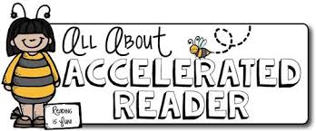
Accelerated Reader

Slide 2
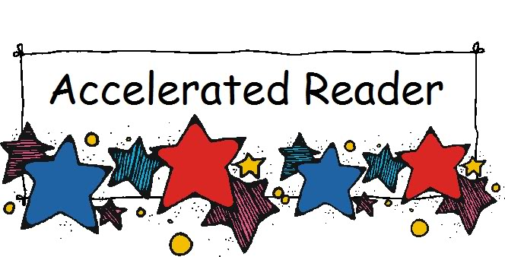
Accelerated Reader: A Guide for Parents
In Years 3 to 6 all children take part in the Accelerated Reader programme, which is designed to do the following things:
Find books that are the right ability for you
Encourage your to read more
Improve your reading ability.

Slide 3
How it works…
At the start of the year you took a Star Test, which is a computer-based test that measures your reading ability through a series of 34 questions.
Every test is different, and the computer selects different questions for you dependent on how well you answer the previous questions. Essentially, the computer adapts the test to suit you.
Once you have completed the test, you are then given a ZPD score by your teacher.
Notes:
https://ukhosted62.renlearn.co.uk/1892677/default.aspx If they can’t find it

Slide 4
A ZPD score is given to you after completing the STAR test
3.2 – 4.6
ZPD is two numbers that you use to choose your next reading book.
The lowest number is the lowest level of book you should be choosing.
The highest number is the highest level of book you should be choosing.
You should keep a record of your ZPDs in your planner.
A new STAR test takes place every half term, so you can see improvements in your reading ability, and then you can choose more challenging books.
Lowest number
Highest number

Slide 5
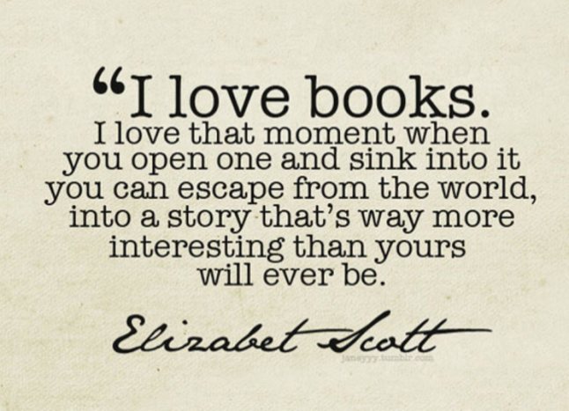
All the AR books in the LRC are colour-coded to help the student find the right one.
0.0 to 1.9
6 and above
2 to 2.9
3 to 3.9
4 to 4.9
5 to 5.9

Slide 6
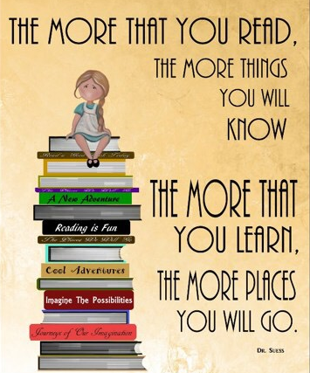
AR Quizzes
A quiz is different to a STAR test because you only take a quiz after they have finished a book.
There are usually about 10 questions on the book that has been read. At the end of the quiz you are given a percentage to show them how well you have done.
There are some important rules for taking quizzes:
The book you are quizzed on must be a book you have read in the last two weeks. AR is not a memory test but rather measuring reading ability.
You cannot take a quiz until they have read the entire text.
Quizzes must be done individually, not with anyone’s help.

Slide 7
Millionaire's Club
Each time you read a book and then take a quiz, you are building up your ‘words read’ total.
The first person who gets to
1,000,000 words
Will win a trip to a bookstore and win…….

