Slide 1
Wednesday 20th January

Slide 2
While we do the register:
Make the calculation correct by moving one match stick.

Slide 3
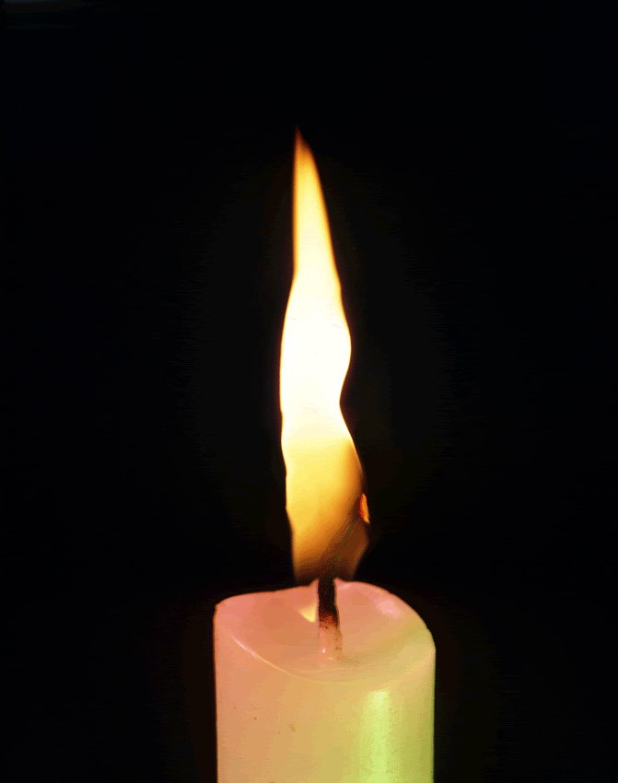

Slide 4
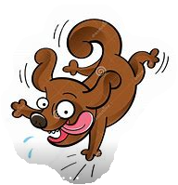
Maths L.O.: To Representing information as a bar model (Part 2)
https://classroom.thenational.academy/lessons/representing-information-as-a-bar-model-part-2-6ct62d

Slide 5
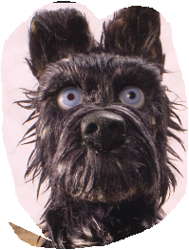
Writing : L.O.: To retrieve information https://classroom.thenational.academy/lessons/to-retrieve-information-61jk4t

Slide 6
Writing L.O: To box up for purpose https://classroom.thenational.academy/lessons/to-box-up-for-purpose-75j3jr

Slide 7
Enjoy reading Little Blending Book.
https://www.oxfordowl.co.uk/api/digital_books/31520.html

Slide 8
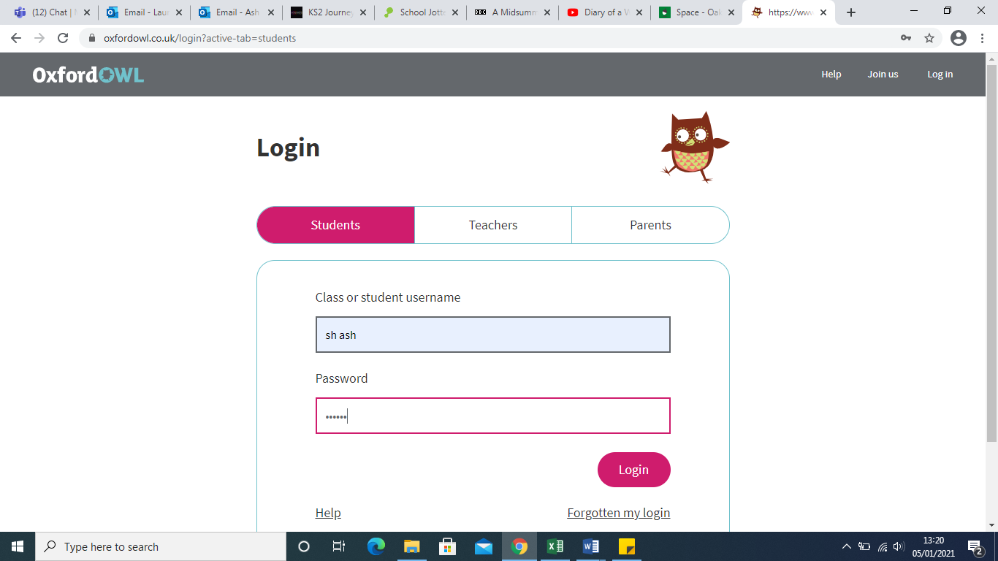
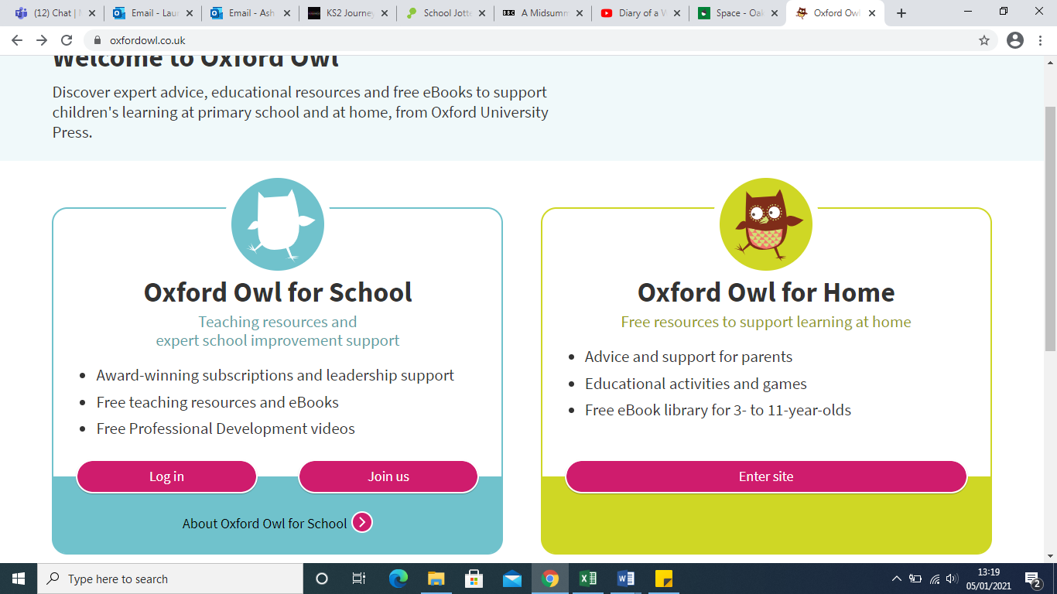
Remember that you can log into ‘Oxford Owl for School’
https://www.oxfordowl.co.uk
Username: sh ash
Password: sh ash

Slide 9
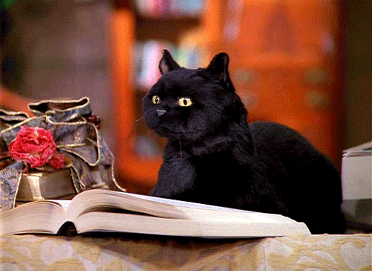
Now spend 30 minutes reading your own book independently.
Don’t forget, you can log into ‘Accelerated Reader’ through the
learn zone in the School Web page. You can also log into Oxford Owl for books to read.

Slide 10
.
Writing
L.O: To box up for purpose
https://classroom.thenational.academy/lessons/to-box-up-for-purpose-75j3jr

Slide 12
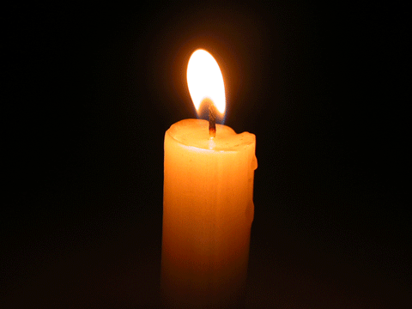
Class Liturgy Challenge: Gather
What do you find challenging?
Try to find a quiet space.
You may be able to set up your own ‘focus table’ too.
Write down some of the things that you find ‘challenging’. Write each on a separate piece of pa per, and place them on your focus table

Slide 13
Introduction
We begin the liturgy by doing the sign of the cross.
In the name of the Father and of the Son, and of the Holy Spirit, Amen.
The Theme for this week is Challenge.
Challenge means to take part in a competition or face difficulties like doing a certain task or work. We always face challenges along our faith journey and we need to use our inner strength that God has given us to face these challenges.

Slide 14
The Word
A reading from the Letter of Paul to the Philippians
(Chapter)4: (Verses) 6
Don't worry about anything, but in all your prayers ask God for what you need, always asking him with a thankful heart.
The Word of the Lord.
R. Thanks be to God.
The word of the Lord
Thanks be to God

Slide 15
This reading tells us that we should trust in God and ask whatever we want from him through prayer. However, we must do this by being thankful and appreciating what God has done for us.
Response to the Word
Listen to the music and words of this song.
Take time to think of some of the things that challenge you, or that you may worry about.
You may want to jot them down on paper.
At the end of the song, place the worries on your focus table.
We are giving our worries up to God.
https://www.youtube.com/watch?v=uWXUWepSak4&list=RDuWXUWepSak4&start_radio=1&rv=uWXUWepSak4&t=30&t=30

Slide 16
For helping us get through this lockdown again and providing us with all the learning and resources that we need.
Lord we thank you.
For helping us during these challenging times.
Lord we thank you.
For giving us strength and comfort in knowing that you are always there.
Lord we thank you.
Prayers
Lord we thank you.

Slide 17
Let us now listen to a hymn. Please join in with the action in the song.
https://www.youtube.com/watch?v=OaW_4MWSE6I
For our mission this week we are going to think about our challenges and pray to God to help us.
Try to make little changes to give something back to make all the hard challenges a little easier for everyone.
Mission

Slide 18
Closing Prayer:
Lord Jesus, thank you for all the things that we have learned today. Even though we may have found some of the things challenging, we tried our very best. Guide us and help us as we learn and pray, love and care.
We ask this through Jesus Christ our Lord.
Amen

Slide 19
Go forth and spread the Word.
Challenge
We end this liturgy in the name of….

Slide 20
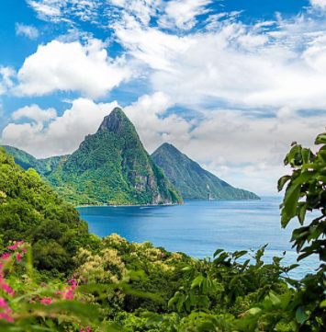
L.O.: To learn facts about the Caribbean
Enjoy the Caribbean PowerPoint

Slide 21
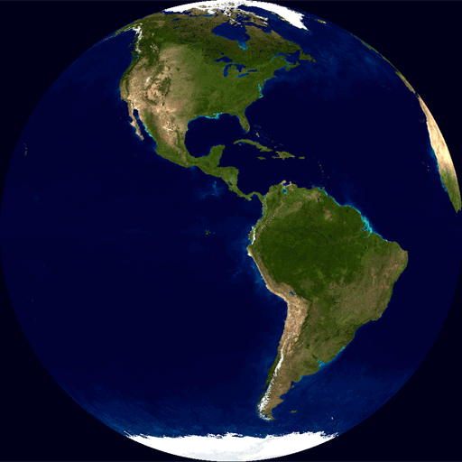
The Caribbean
Travels with Ms. Chapman & Mrs Southall!

Slide 22
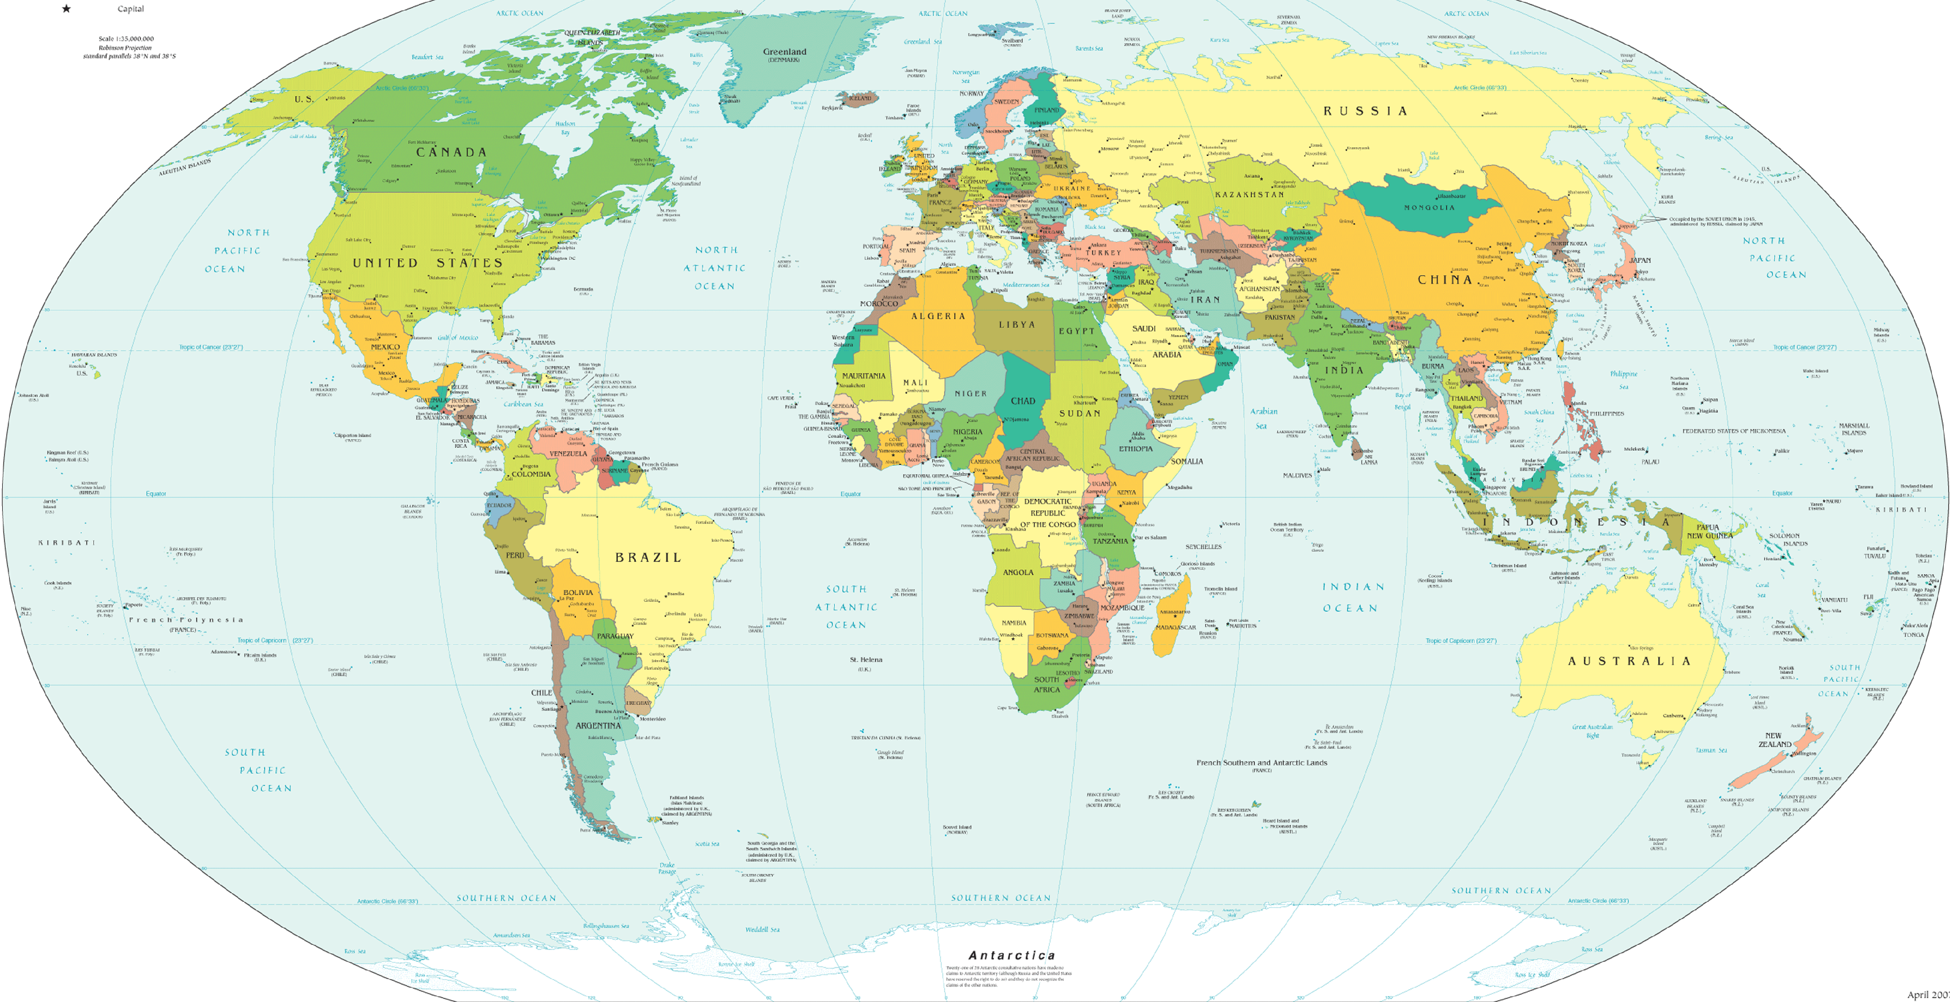
Mrs Southall is the UK
Miss Chapman is in The Caribbean

Slide 23
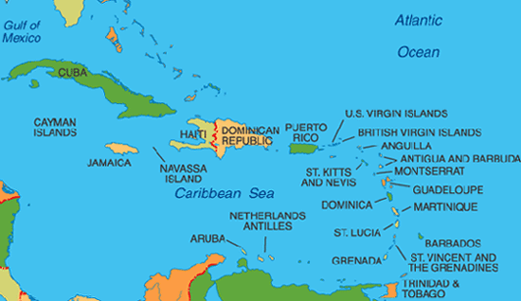
The Caribbean Islands

Slide 24
Cuba
Jamaica
Trinidad and Tobago
Dominican Republic
Bahamas
Barbados
Puerto Rico
Cayman Islands
Antigua and Barbuda

Slide 25
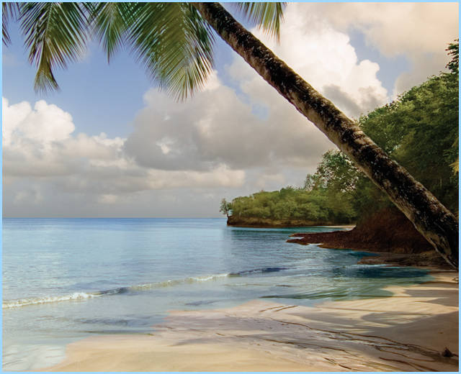
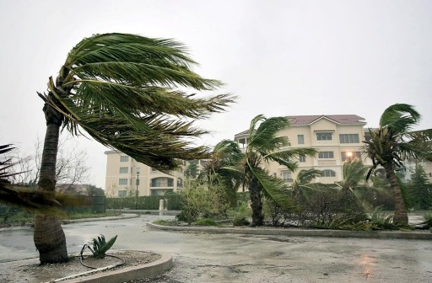
The weather in the Caribbean is tropical
They also have rainy seasons and hurricanes

Slide 26
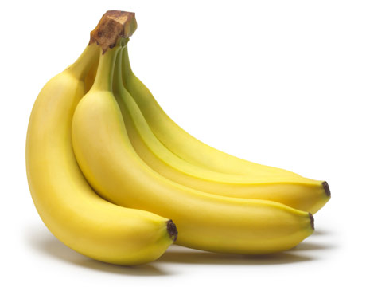
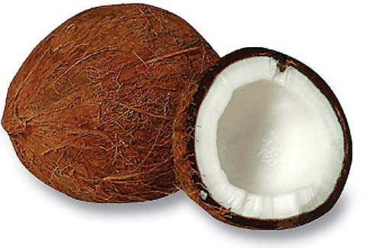
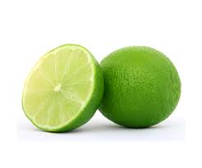
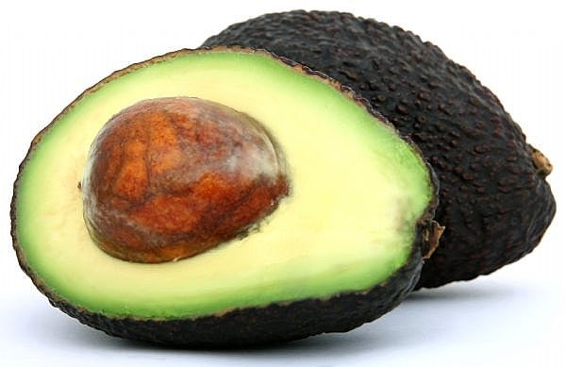
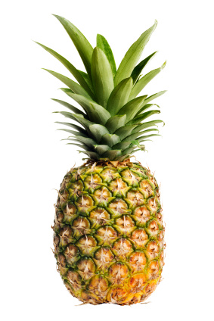
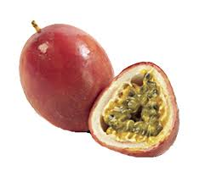
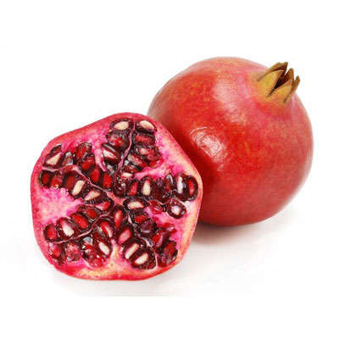
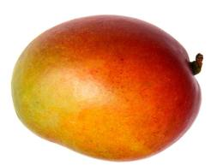
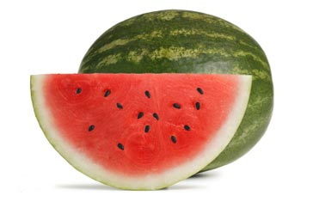
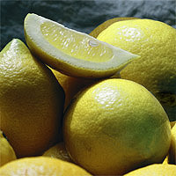
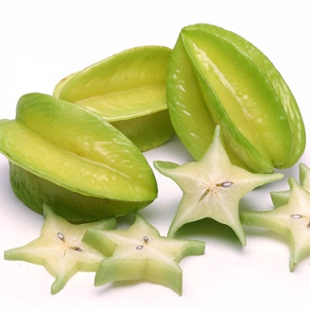
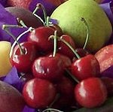
Here are some of the fruits you will find in the Caribbean

Slide 27
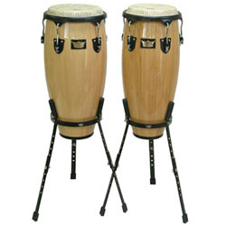
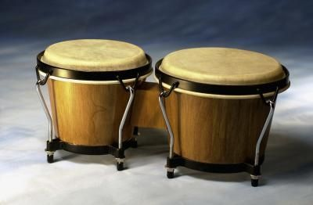
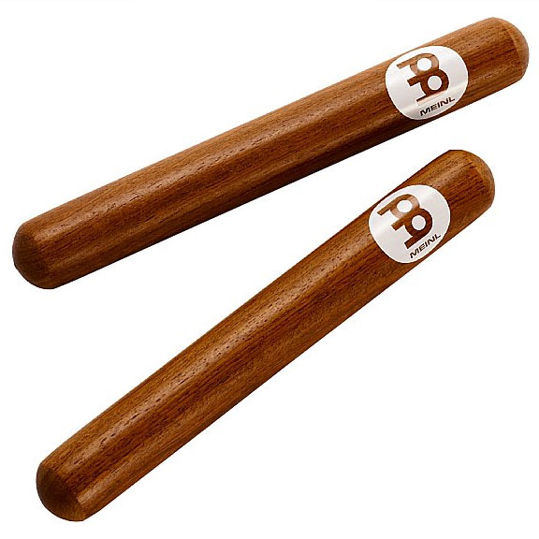
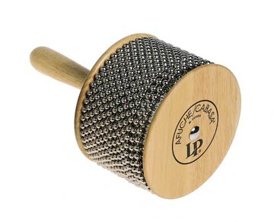
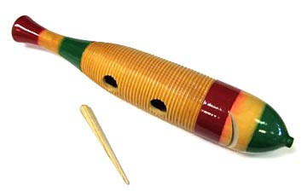
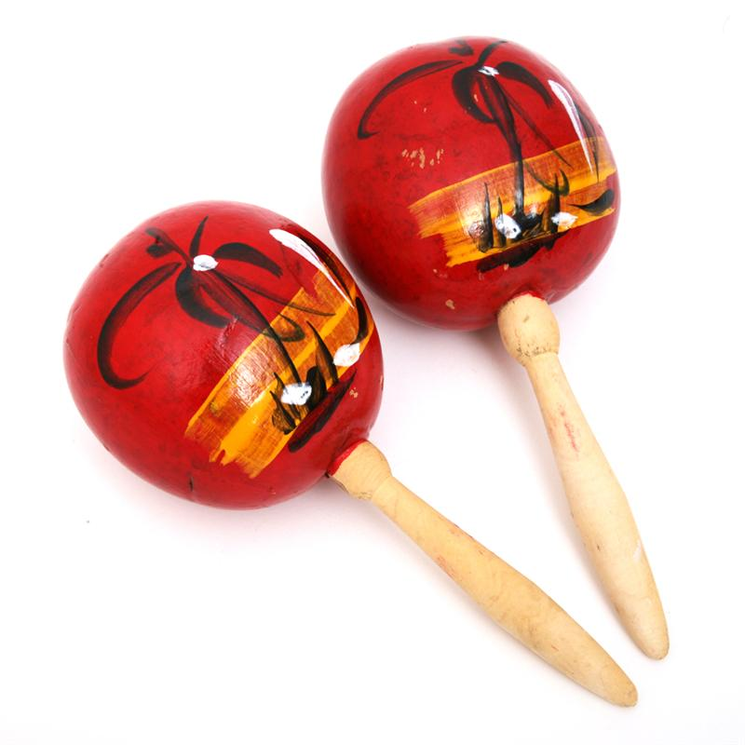
Bongos
Congas
Claves
Cabasa
Guiro
Maracas
Here are some of the instruments you might find in the Caribbean

Slide 28
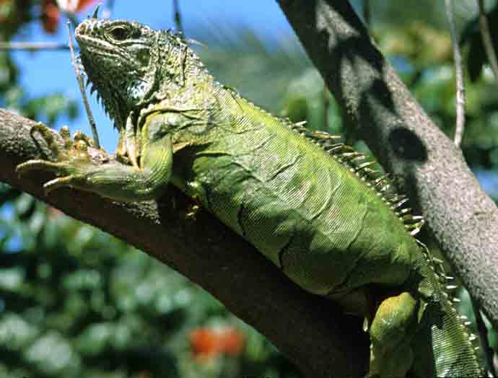
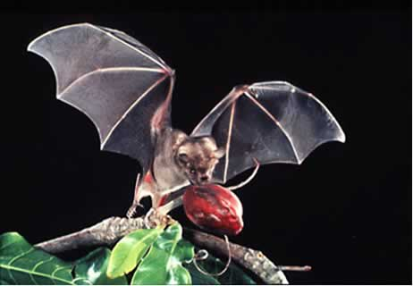
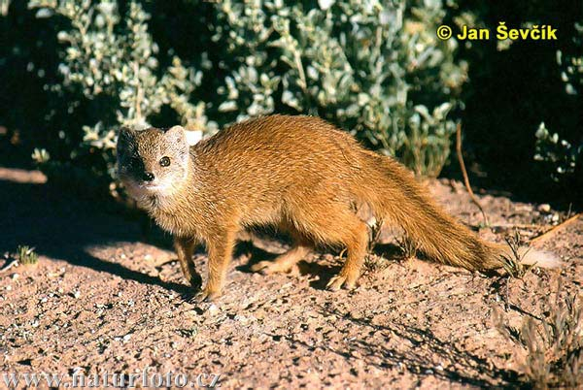
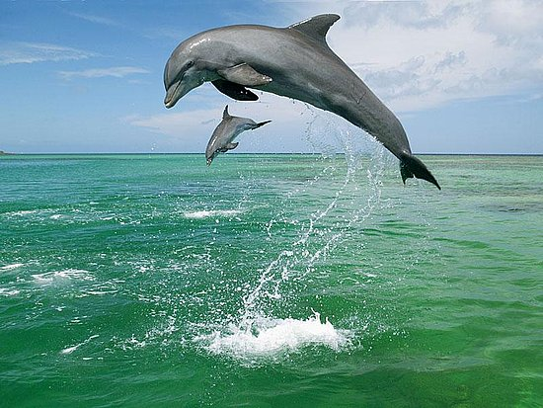
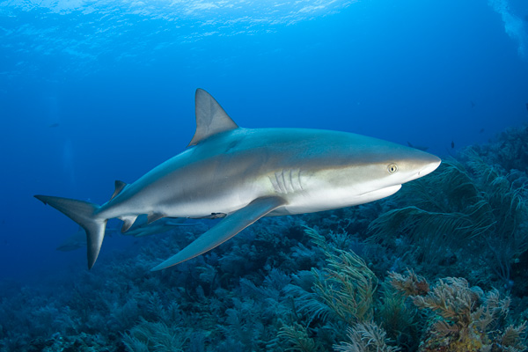
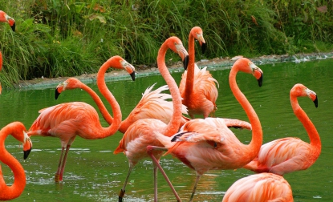
Here are some of the animals you would find in the Caribbean
Iguana
Fruit bat
Mongoose
Shark
Flamingo
Dolphins

Slide 29
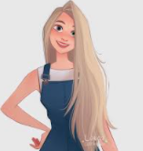
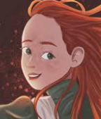
What have you learnt about the Caribbean?
Write 10 facts about the Caribbean

Slide 30
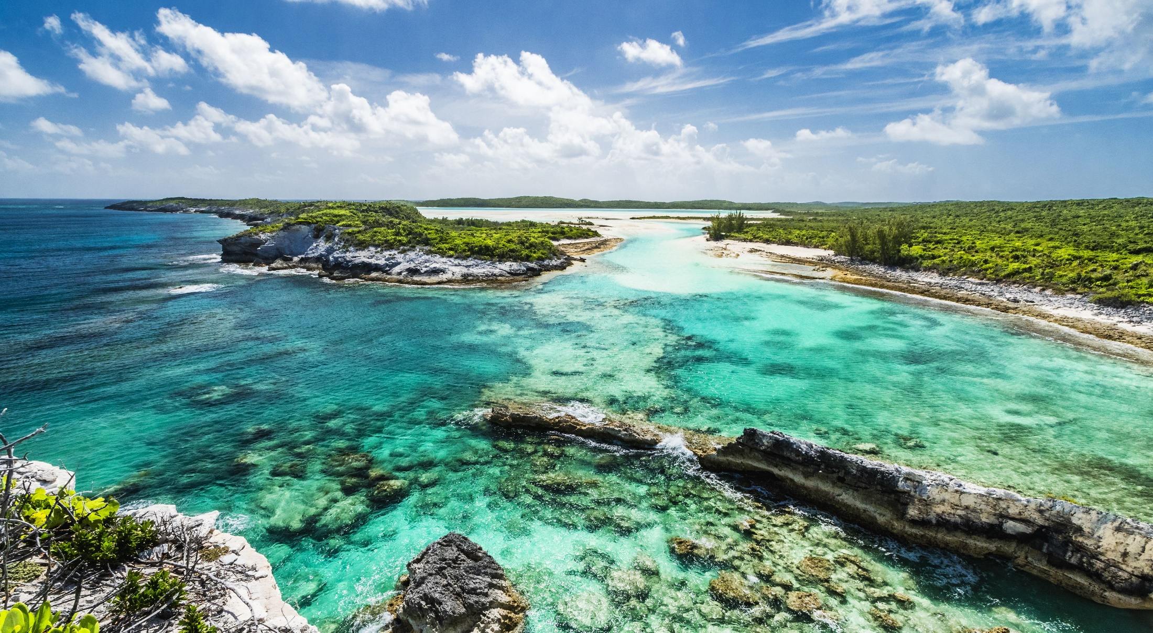
Well done for completing 10 facts about the Caribbean.
Now, send it to your class email address

Slide 31
Phonics Two phonics lessons today:
ch
sh
https://www.youtube.com/watch?v=mGSFG37LewA
https://www.youtube.com/watch?v=7gBsGxhdt2E

Slide 32
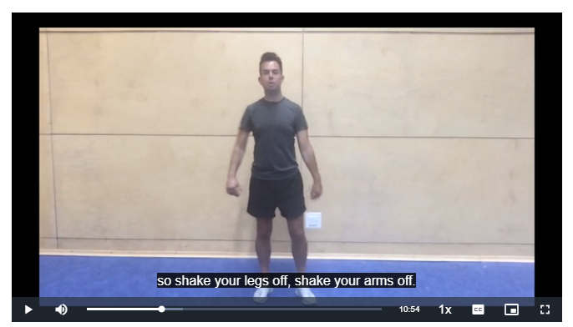
PE Fitness Circuits
Mr Stovell would like you to have a go at the lesson below (follow the link) which looks at Fitness Circuits.
https://teachers.thenational.academy/lessons/fitness-circuit-part-1-dynamic-movements-6cuk4c

Slide 33
Class Story: Continuing our new class story:
Copy the link below for the Fifth Chapter
boy at the back of the class chapter 5

Slide 35
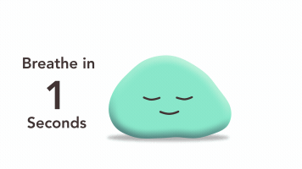
Pause and take a moment. Let good thoughts shine out of you :
We’ll see you all on ZOOM tomorrow morning.
Same time, same place.

