Slide 1
Thursday 11th February

Slide 2
I am full of holes; I hold water, what am I?
What gets wet when drying?
What can’t be used until it’s broken?
What has many keys but can’t open any doors?
What has four legs and only one foot?

Slide 3
I am full of holes; I hold water, what am I?
A sponge
What gets wet when drying?
A towel
What can’t be used until it’s broken?
An egg
What has many keys but can’t open any doors?
A piano
What has four legs and only one foot?
A bed

Slide 6
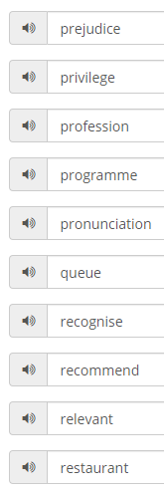
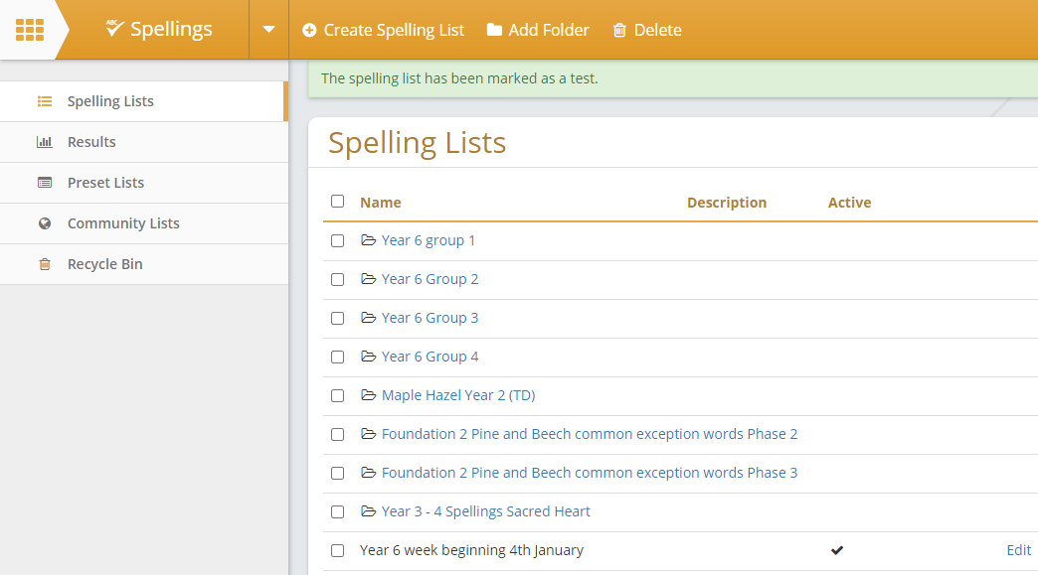
Spend 10 minutes practising your new spellings. Log into the school web page.
This should take you to different spelling lists to practice.
Look for the Year 6 spellings (at the bottom of the page)
Record the words you have learnt in your best joined handwriting.
Click on the orange ‘Spellings tab’
Click on ‘All spellings’ on the left.
It will take you to these lists :

Slide 7
Maths L.O: To use formula in different contexts
How do I find the perimeter of any square?
How do I find the perimeter of any rectangle?
How do I find the area of any rectangle?

Slide 8
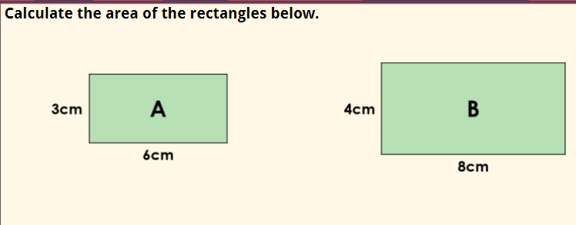

Slide 11
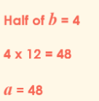

Slide 12
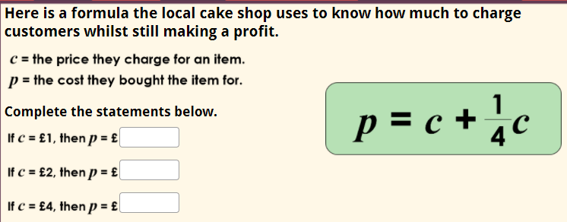
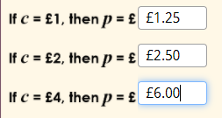

Slide 14
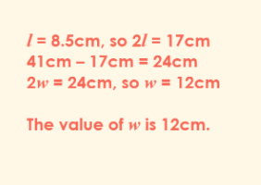

Slide 16
Have a quick 5 minute break:
https://m.bbc.co.uk/new/newsround

Slide 17
Writing: L.O.: To write the opening of a diary entry
What do we use a colon for? Can you think of an example?
What is the difference between formal and informal tone? Which should you use in a diary entry?
https://classroom.thenational.academy/lessons/to-write-the-opening-of-a-diary-entry-cmt3er

Slide 18
Writing: LO: To plan the main body of our diary entry
Why is it good to write a plan?
https://classroom.thenational.academy/lessons/to-plan-the-main-body-of-my-diary-entry-74v3jd

Slide 19
Spelling Unit 12 plural nouns To investigate more plural suffixes using –es and -ves
determined
vegetable
exaggerate
yacht
apparent
bargain
https://kids.wordsmyth.net/we/

Slide 20
Spelling Unit 12 plural nouns To investigate more plural suffixes using –es and -ves
advice advised
advise
devise
device
licensed
licence
practice
practise
practised

Slide 21
Reading Comprehension: L.O.: To read a new text and consider author’s language
Have you seen any of these images before? What are they?
The Blitz survivor stories
https://classroom.thenational.academy/lessons/to-read-a-new-text-and-consider-the-authors-use-of-language-c8rkjt

Slide 22
Now spend 30 minutes reading your own book. Don’t worry if you don’t have a dog to read to, choose a brother or sister, or do it on your own!
Accelerated Reader
Don’t forget to
log into ‘Accelerated
Reader’ through the
learn zone in the School Web page.
You can also log into Oxford Owl for books to read or https://www.myon.co.uk/login/index.html

Slide 24
Collective Worship : Meditation.
The slides for meditation were too large to send to you, so you will find them on the class ‘Learn’ page on the school web site.
Find somewhere quiet and still, and enjoy.

Slide 25
Science
LO: To identify the characteristics of different types of animals and classify a creature based on its characteristics.
Success Criteria
I can identify different types of animals.
I can match the types of animals to their characteristics.
I can design a creature that has a set of characteristics of one type of animal.
I can classify creatures based on their characteristics.

Slide 26
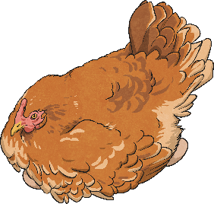
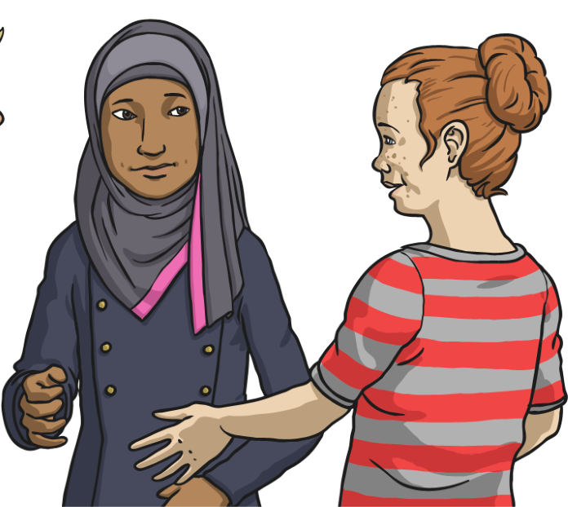
Groups of Animals
In Year 4 you learnt about different types of animals. These animals can be classified into two groups, vertebrates and invertebrates.
What is the difference between the two groups?

Slide 27
Groups of Animals
Could you remember the difference? Vertebrates have a backbone, and invertebrates don't have a backbone.
The two groups can be split into further, smaller groups. Groups of invertebrates include insects, arachnids, annelids, molluscs, crustaceans and echinoderms.
What groups can vertebrates be sorted into?

Slide 28
Groups of Animals
How many did you think of? Vertebrates can be sorted into mammals, birds, fish, reptiles and amphibians.

Slide 29
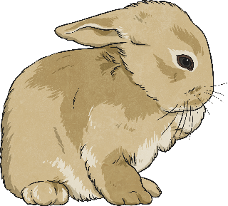
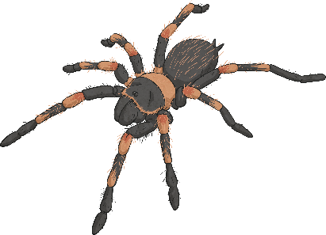
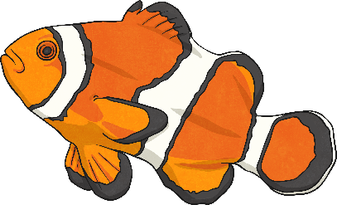
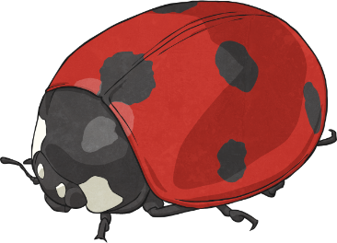
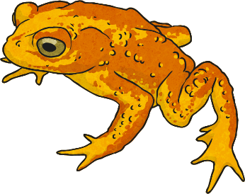
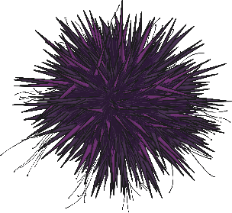
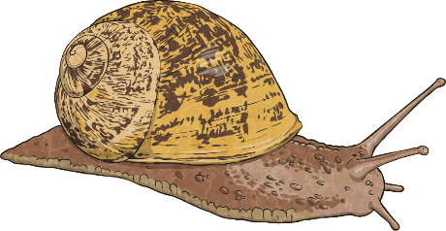
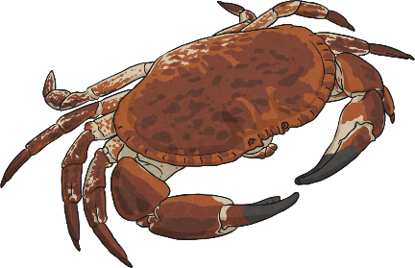
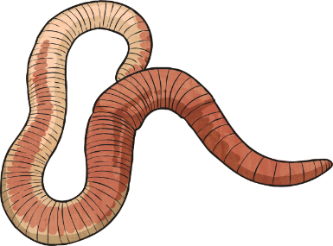
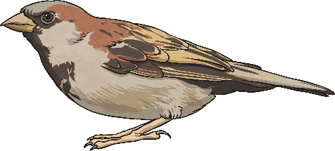
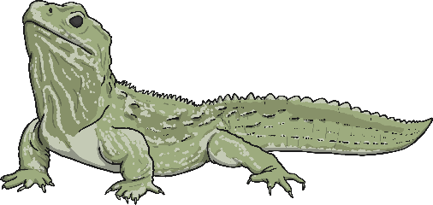
Groups of Animals
There are lots of different groups of animals! Can you think of an example animal for each group? Think about what you learnt in Year 4. Use the pictures to help you.
mammals
arachnids
fish
insects
molluscs
amphibians
echinoderms
birds
crustaceans
reptiles
annelids

Slide 30
Task 1: Identifying Characteristics
Each group of animals is defined by a set of characteristics. The animals in a particular group share similar characteristics, and are different to the animals in other groups. Can you recall any of the characteristics of each group of animals?
Write the statements on the Characteristics Activity Sheet (on the next page) beside the correct animal group to show the characteristics of each group of animals.

Slide 31
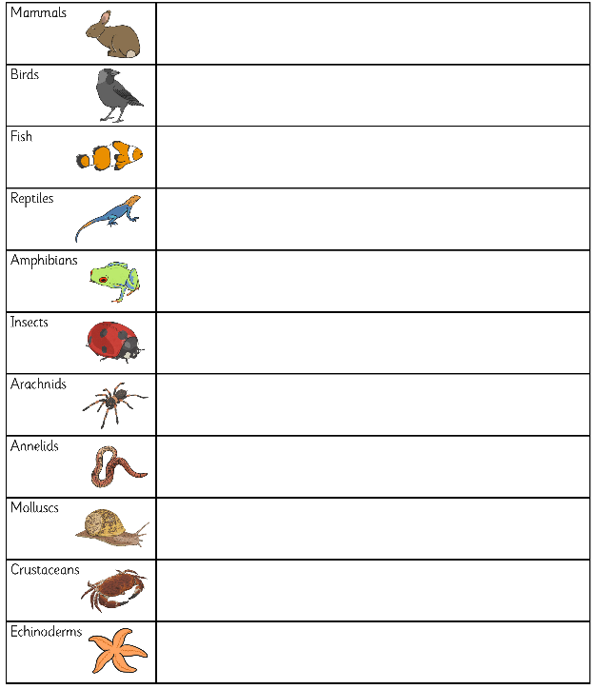
Task 1: Identifying Characteristics

Slide 32
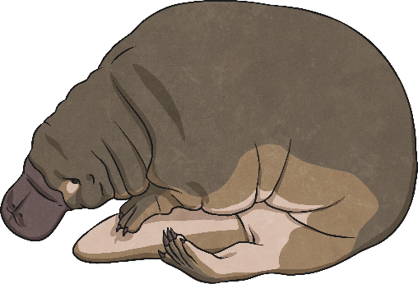
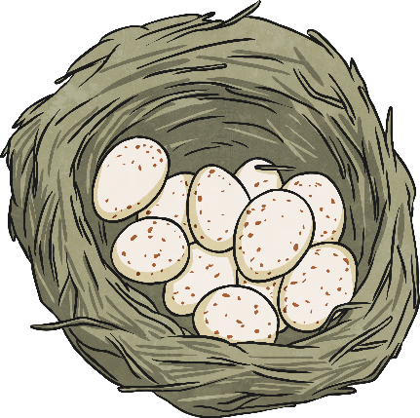
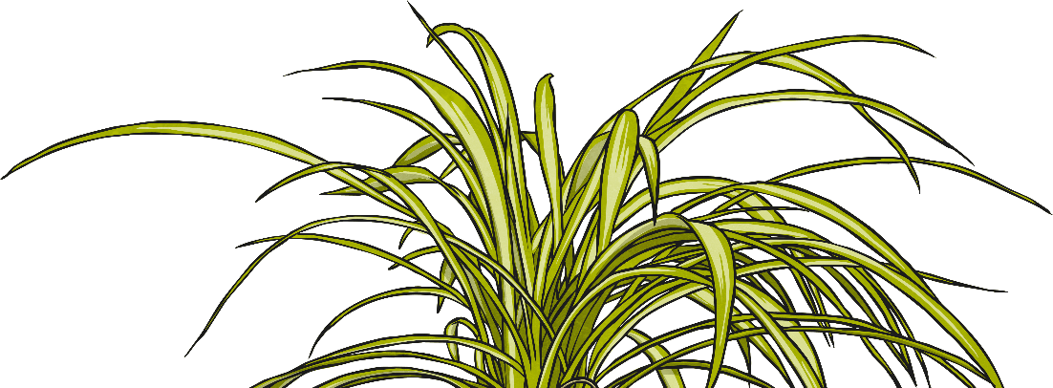
Curious Creatures
When a new species of animal is discovered, taxonomists observe its characteristics to decide how to classify it. However, some animals are so unusual that taxonomists struggle to classify them.
The platypus was discovered in 1797, and scientists around the world joined the attempt to classify this unusual animal. It seemed to have characteristics from several different types of animals!

Slide 33
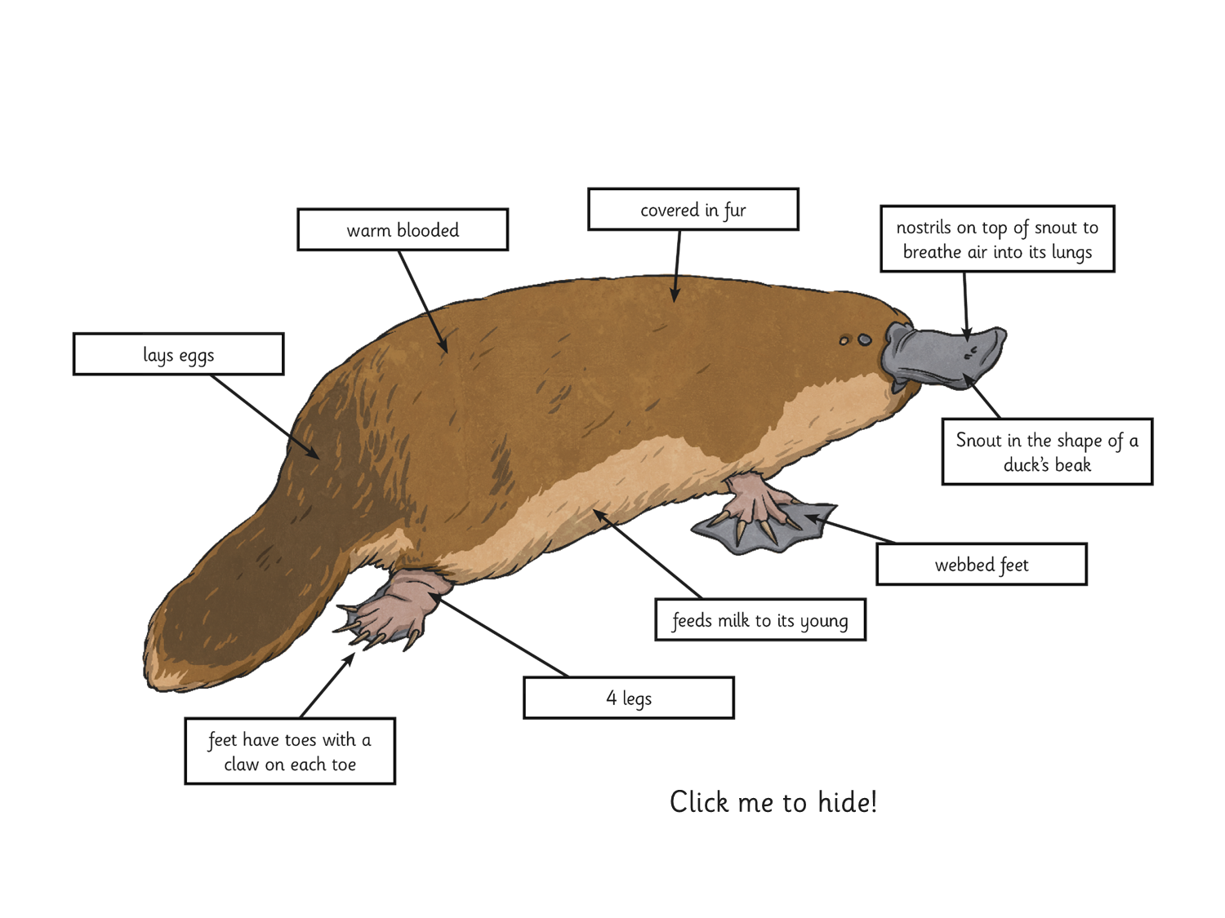
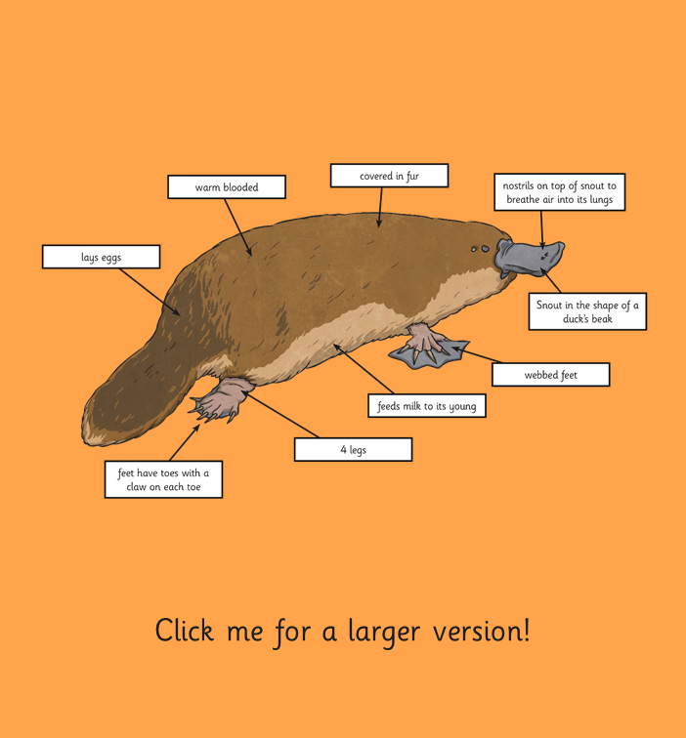
Classifying Curious Creatures
Look at the Platypus Diagram and its characteristics and talk to your partner about which groups of animals this curious creature could fit into.
Use your completed Characteristics Activity Sheet to help you.
It took taxonomists and other scientists nearly 100 years of discussions and arguments to agree on a classification for the platypus!
Some thought it was a reptile, because it lays eggs. Others thought it was a bird, because of its beak shaped snout and the facts that it lays eggs and is warm blooded.
It is now agreed that the platypus is a mammal, because it has fur, it feeds milk to its young and it is warm blooded. It does not have wings or feathers, so can't be a bird. It does not have hard scaly skin, so cannot be a reptile.

Slide 34
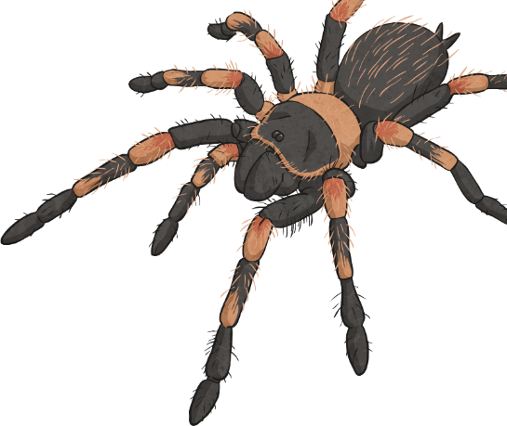
Task 2: Curious Creatures Activity
Imagine you have discovered a new creature. You will draw a picture of your animal and create a fact file detailing its characteristics.
Before you design it, think about what group of animals it will belong to. Make sure you include the characteristics of that group.
Once you have designed your animal and completed its fact file, write next it which group of animals it would classify as.
For example, you may want to design a new species of arachnid. It should have 4 pairs of jointed legs and be cold blooded. Its front pair of legs may be used to hold its prey. It should not have antennae. Your new animal could then be any shape, size or colour as long as it displays these characteristics.

Slide 35
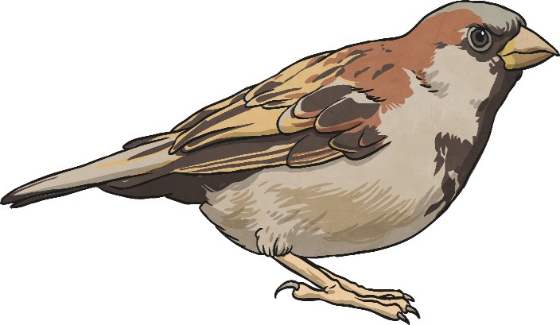
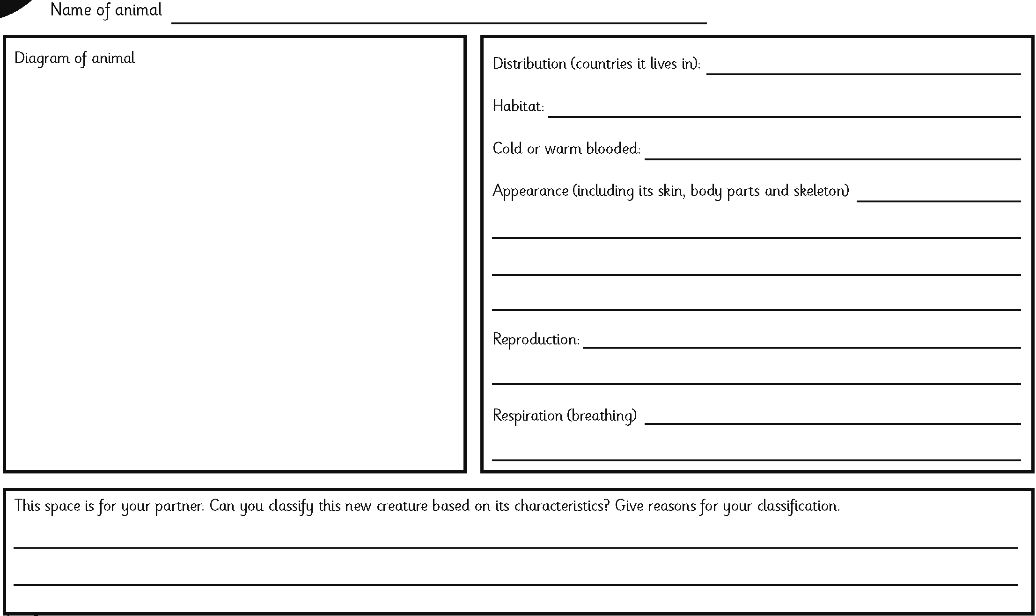
Task 2: Curious Creatures Activity
Use the Curious Creatures Activity Sheet to design your animal and complete its fact file.

Slide 36
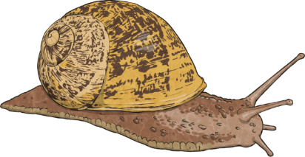
Music LO: To understand the tempo of music
The ‘tempo’ of music means how fast or slow it is It can be measured in BPM (beats per minute) ‘Happy Birthday’ is roughly 85 BPM.
What is tempo?
Speed: how fast or slow a piece of music is.

Slide 37
On our school jotter page there are some clip of music, some incredible music, some you may know.
Listen to the clips of music and I want you to think about the tempo of each piece.
Use clapping and/or moving from side to side and/or tapping your foot to help you identify the pattern of strong beats in the song.

Slide 38
After listening to the songs and clapping the beat, decide which tempo you think best describes each piece of music. Then write a sentence about how each piece makes you feel.

Slide 39
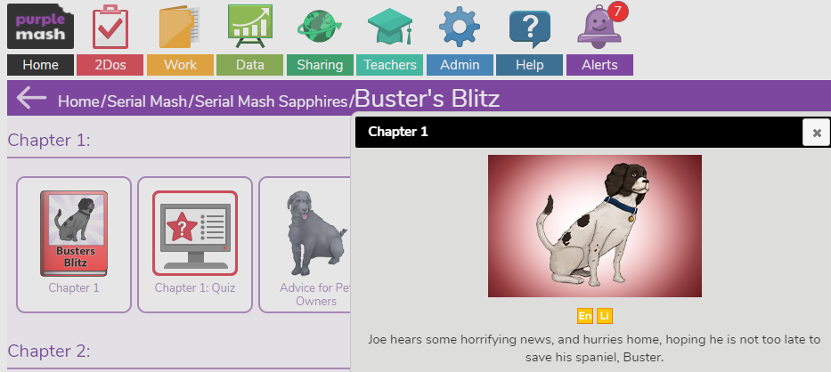
Purple Mash Reading Comprehension. ‘Buster’s Blitz’ : Chapter 2
Buster’s Blitz
Joe hears some horrifying news and hurries home, hoping he’s not too late the save his spaniel, Buster.
Today we continue with the theme of the blitz, with a new comprehension task.
Each Chapter is set as a ‘2do’ on Purple Mash.
Find purple mash on the school website ‘learn page’
If you have forgotten your log in, just email and ask.

Slide 41
Class Story time: Zoom
Join the rest of the class through your normal zoom link for the next instalment of our story.

