Slide 1
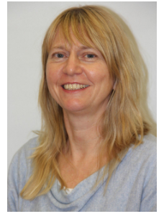
Maths Workshop for Parents
Mrs Southall & Mr Ashenhurst

Slide 2
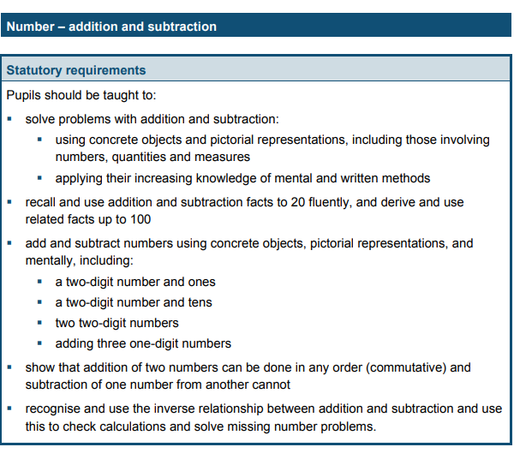
The National Curriculum
Example from Y2

Slide 3
Mathematics across the year:
Autumn
https://www.sacredheart.leicester.sch.uk/class-pages/year-2

Slide 4
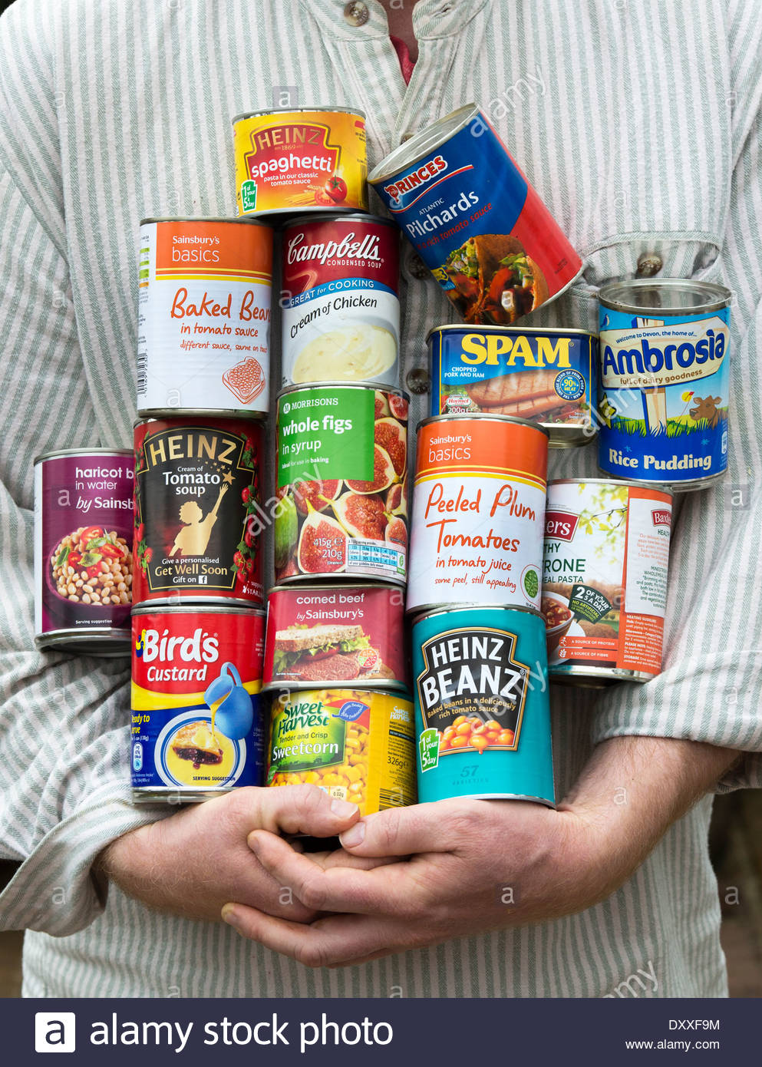
Foundation counting out and about…

Slide 5
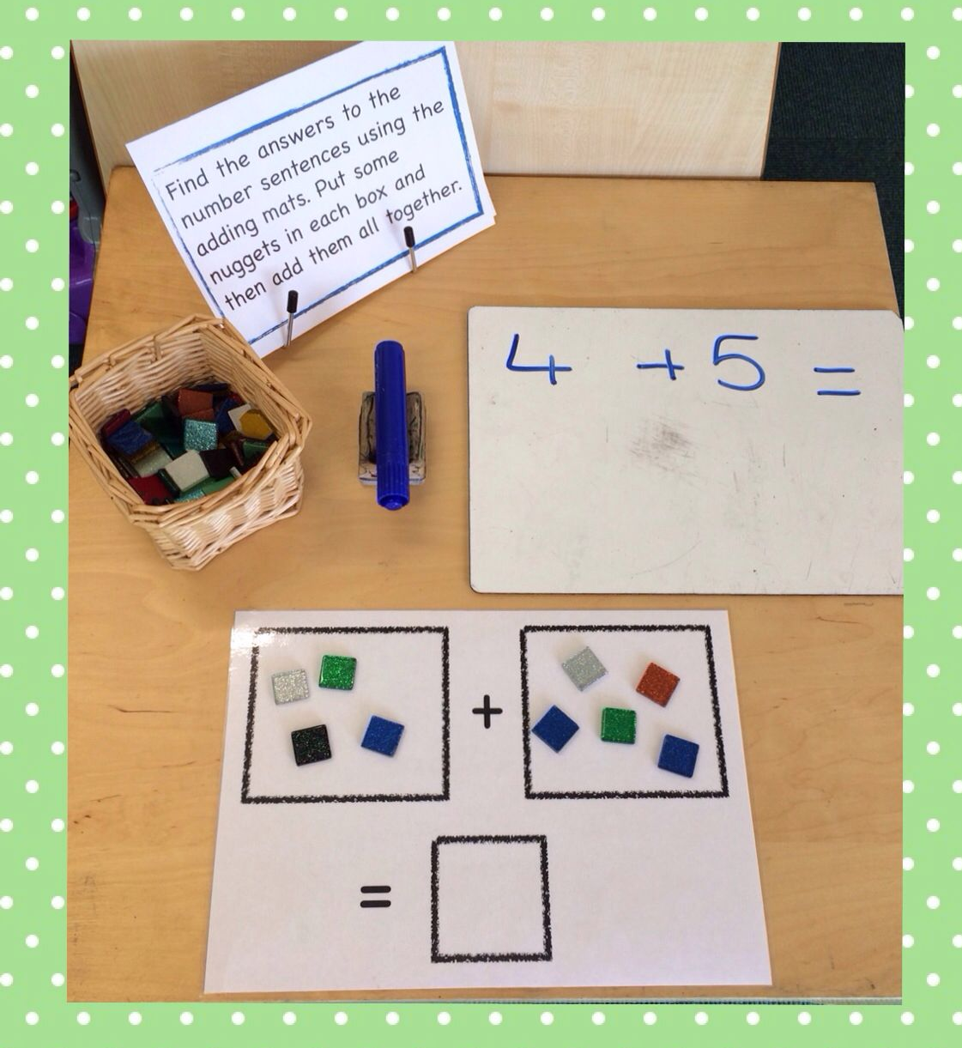
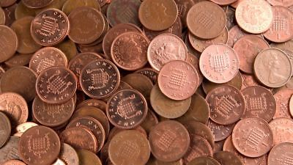
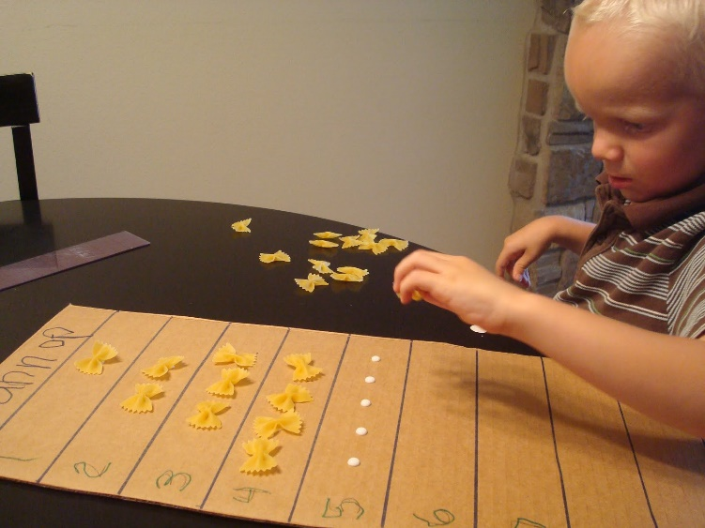
Foundation
Without a number
sentence

Slide 6
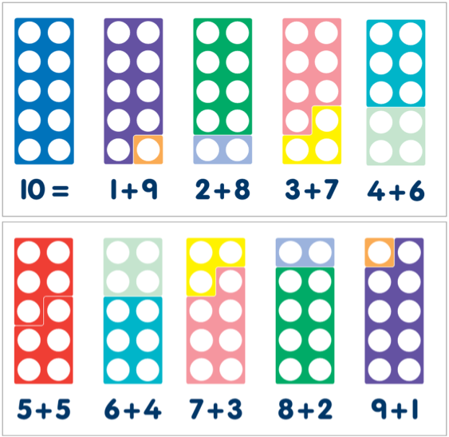
Numicon
Number bonds to 10
Not just within 10

Slide 7
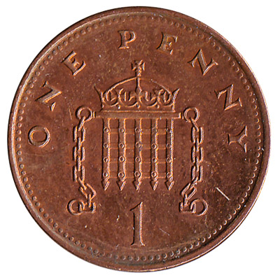
Number bonds to e.g. 7
Using Coins
2
5

Slide 9
Number bonds to e.g. 8

Slide 10
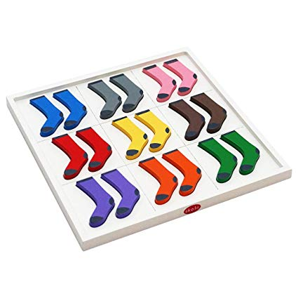
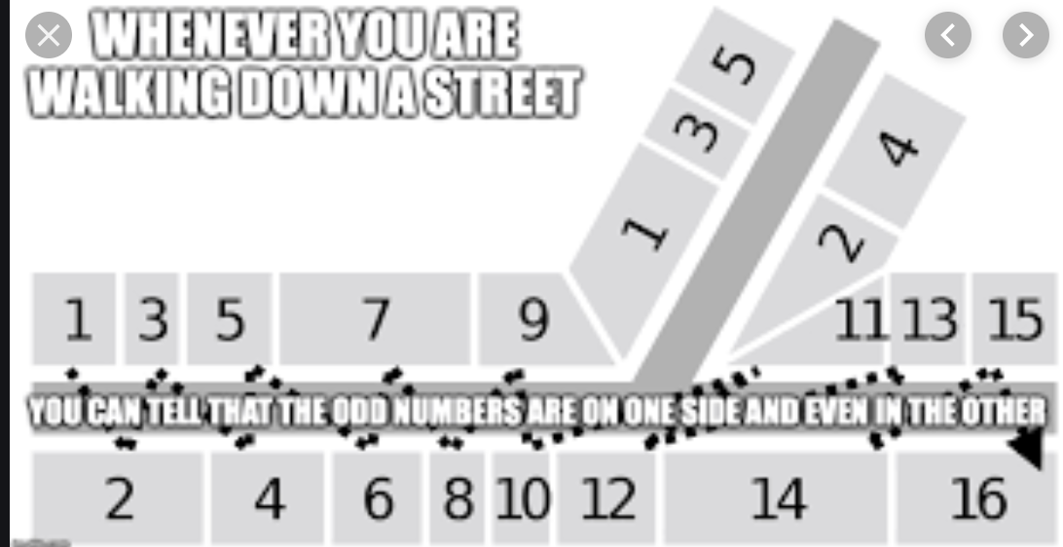
Counting in 2
Pairing Socks
Knife & Fork
Body Parts
Walking down Road

Slide 11
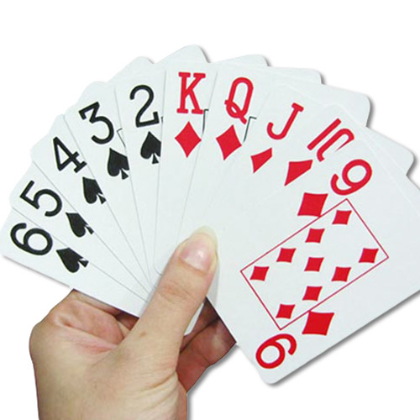
Number bounds:
2,3,4,5,6,7,8,9,10
Number Bonds
Times Table Game

Slide 12
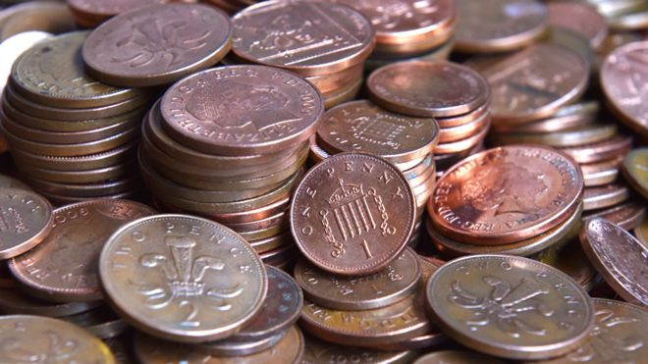
Y2 – Times Table in the back of the planner
Using Coins to Make Arrays
3x4=

Slide 13
5 & 10s

Slide 14
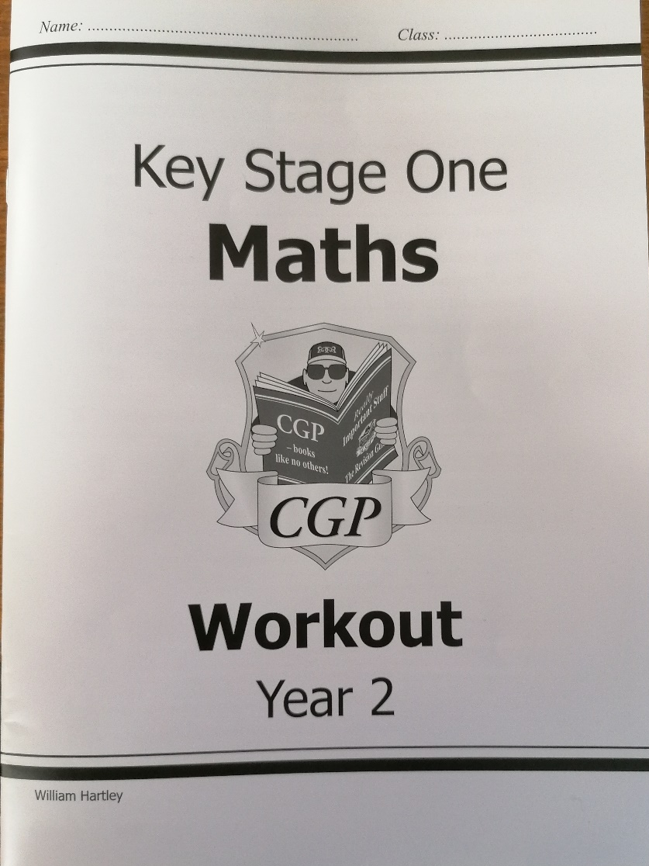
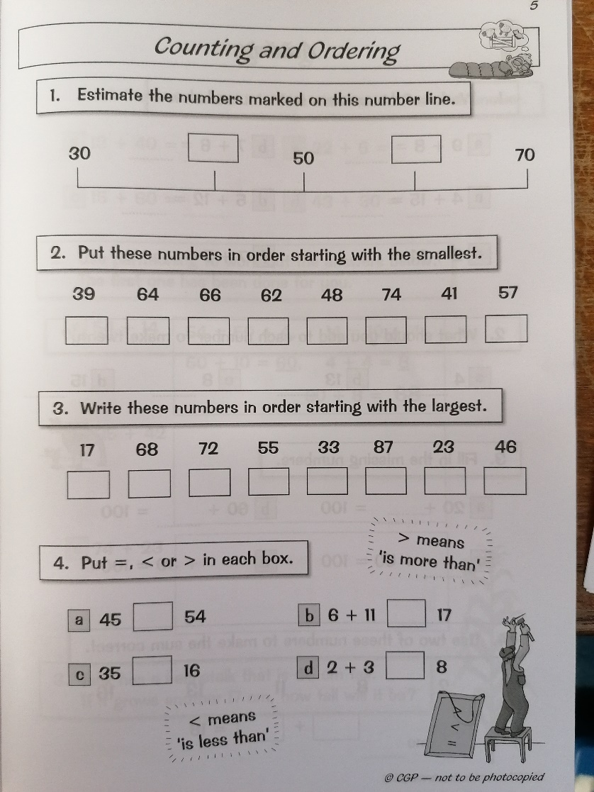
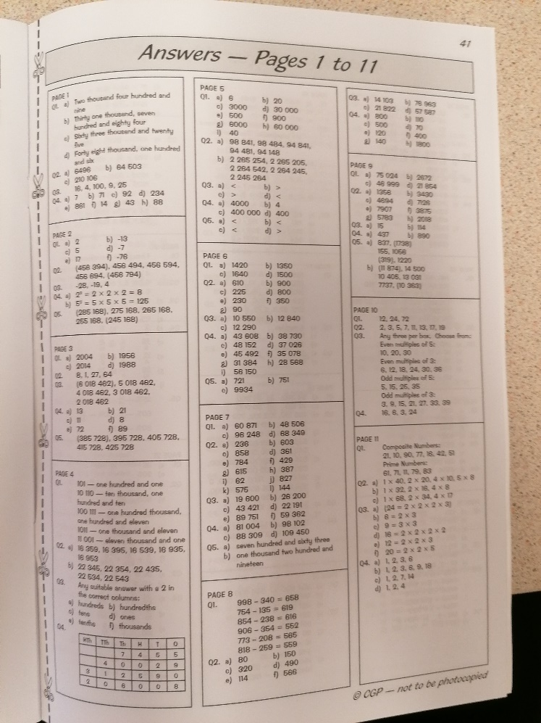
KS1 – Math’s Homework Book
Answers
The teacher will set a page(s) to be completed each week
Year 1 &2

Slide 15
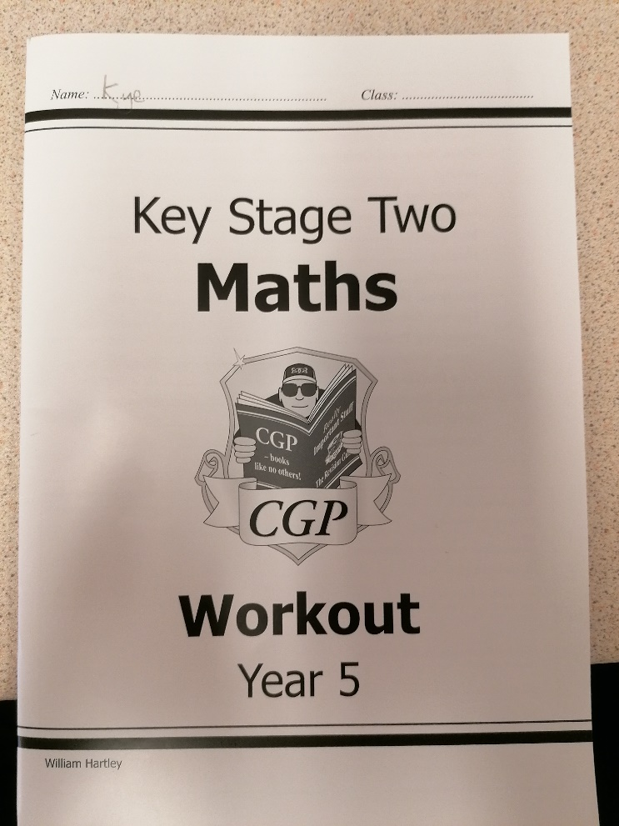
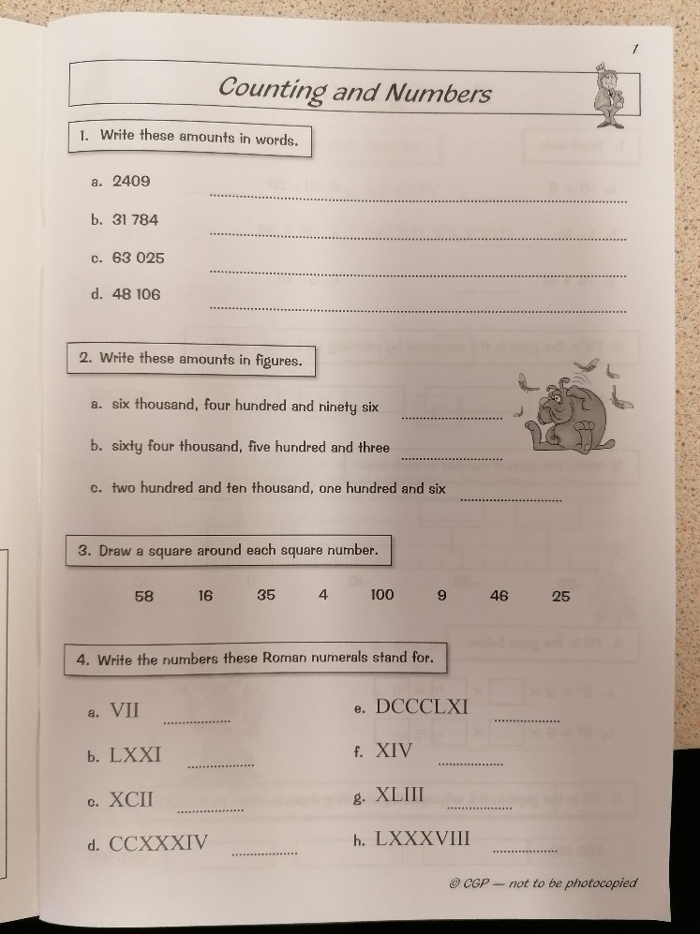
KS2 Homework
Answers
The teacher will set a page(s) to be completed each week
Year 3, 4, 5 & 6

Slide 16
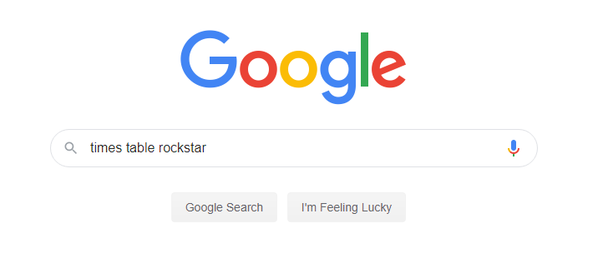

Slide 17
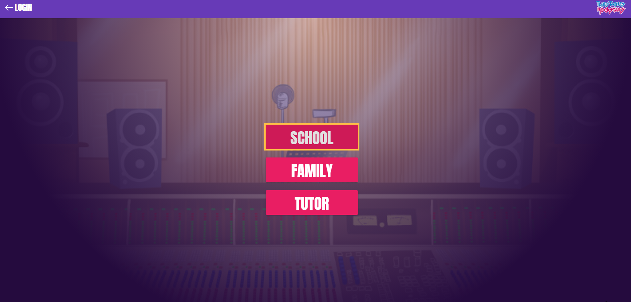

Slide 19
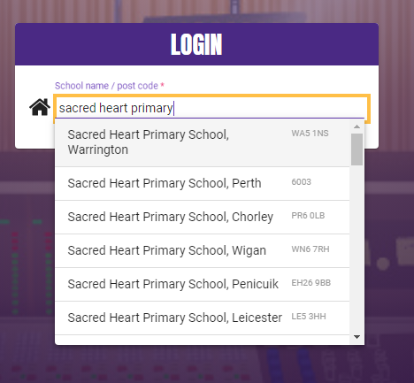
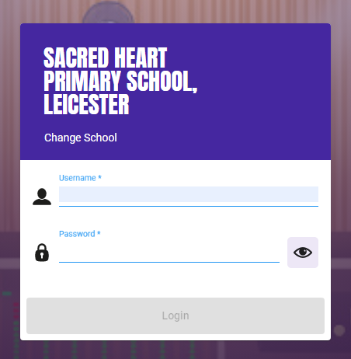
Type: sacred heart
primary
Enter your child's
login

Slide 20
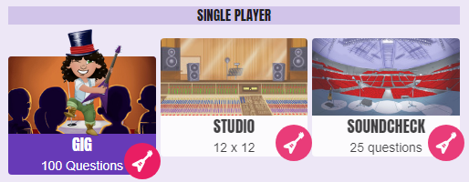
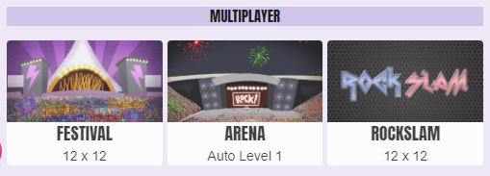
Y4 times table test
practise
Challenge a
school friend
Up to x12
Your child’s level

Slide 21
KS2 - Calculations
Multiplication & Division
We are not testing you!
COPY US!

Slide 22
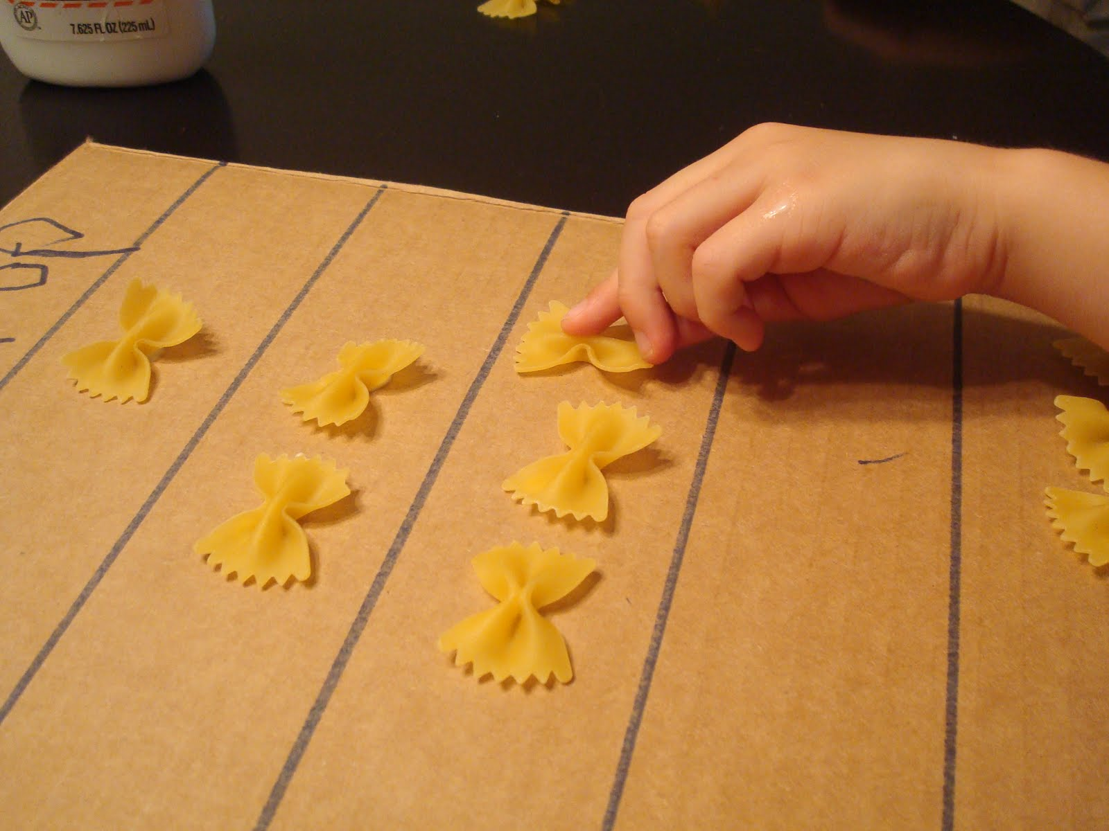
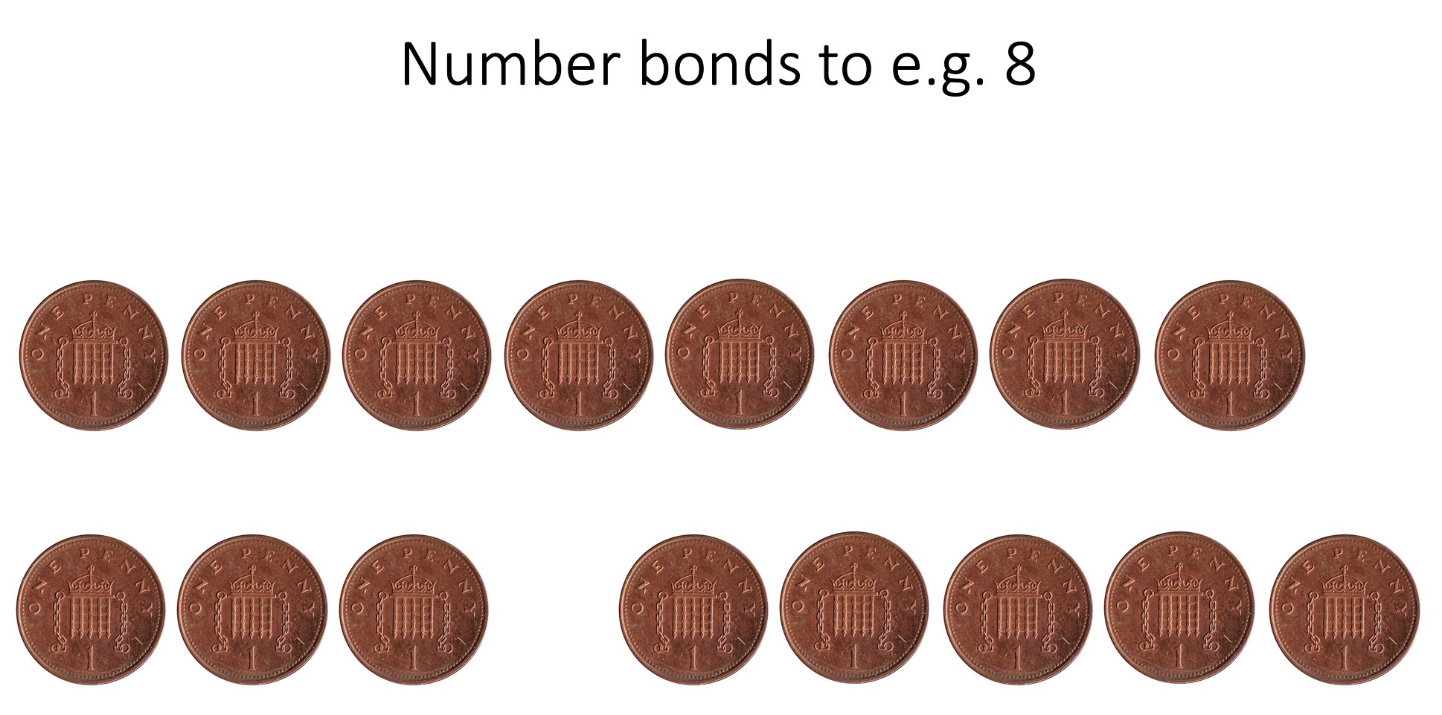
Foundation
KS2
Number bonds
Times Tables
3+2=5
&
5=2+3
KS1
http://www.primaryhomeworkhelp.co.uk/maths/

Slide 23
On going guidance…
If you require any guidance
come speak to us.
We could run another session on e.g.
fractions
ratio
percentages

