Slide 1
The story of
Our Lady of Lourdes

Slide 2
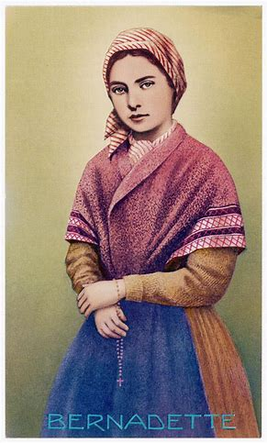
The story of Lourdes is well known. Between February 11 and July 16, 1858, the Blessed Virgin Mary appeared eighteen times to fourteen year-old Bernadette Soubirous in that small town located in the foothills of the Pyrenee mountains of southern France. Bernadette was born on January 7, 1844, the eldest of six children of Francis Soubirous and Louise Caserot.
She was a delicate girl who suffered from asthma and cholera. She could neither read nor write and spoke only the Burgundian dialect of her area. Her family was sinking into poverty, and the day the first apparition took place she went to gather firewood along the bank of the River Gave to help her mother.

Slide 3
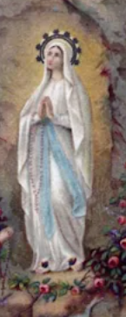
Her attention was drawn to the noise of rustling bushes near the Grotto of Massabielle, from the French vieille masse meaning ancient mass. Then Bernadette saw a beautiful young girl of sixteen or seventeen. She described this girl as "dressed in a white robe, girded at the waist with a blue ribbon. She wore upon her head a white veil which gave just a glimpse of hair. Her feet were bare but covered by the last folds of her robe and a yellow rose was upon each of them. She held on her right arm a rosary of white beads with a chain of gold shining like the two roses on her feet."

Slide 4
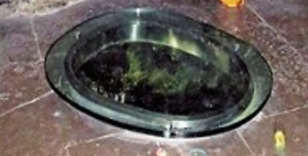
Bernadette knelt and began to pray the rosary. At the end of the five decades the woman smiled and disappeared. The young visionary returned and on February 18 Our Lady began her message telling young Bernadette, "I do not promise to make you happy in this life but in the next." On February 24, Mary asked for penance and prayer for the conversion of sinners and the following day, she instructed Bernadette to dig the ground near the grotto. From that a spring came forth which to this day is used for the bath by pilgrims to Lourdes

Slide 5
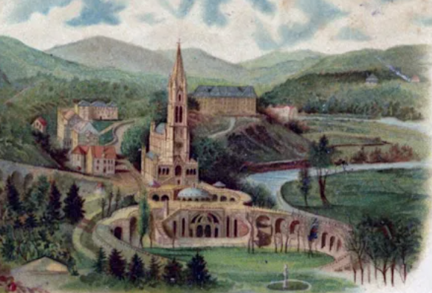
At the apparition of March 2, Bernadette was instructed by Our Lady to "tell the priests that people should come here in procession and that a chapel should be built on the site." On the Feast of the Annunciation, March 25, the Blessed Virgin told Bernadette in the dialect of Lourdes, " I am the Immaculate Conception."
The Basilica at Lourdes was consecrated in 1876 and the faithful, countless in number, flock in pious pilgrimage

Slide 6
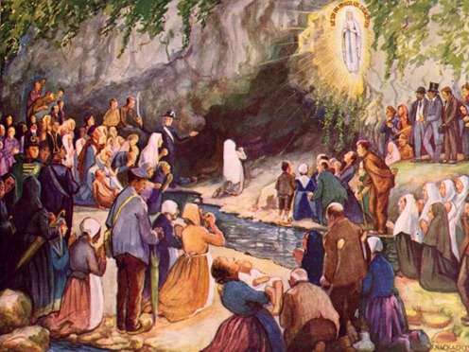

Slide 7
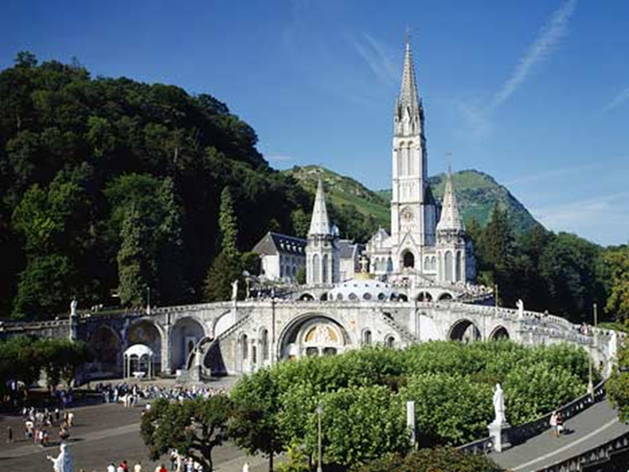
Lourdes Basilica - France

Slide 8
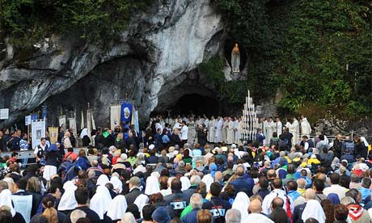
The grotto where Mary appeared to Bernardette

Slide 9
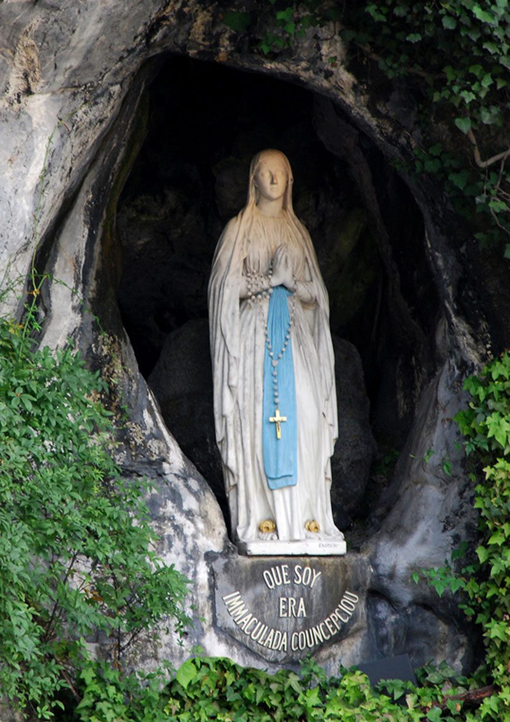
A statue of the lady referred to as ‘Our Lady of Lourdes’ was built in the place where Bernadette saw her.

Slide 10
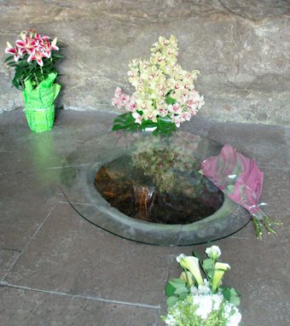
Original spring discovered by Saint Bernadette in Lourdes in 1858.

Slide 11
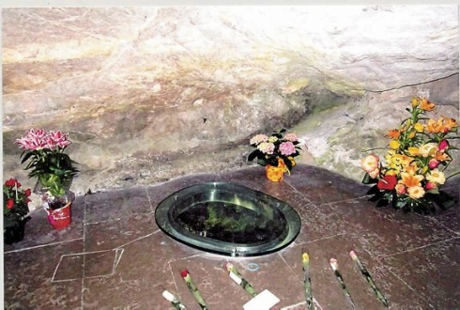

Slide 12
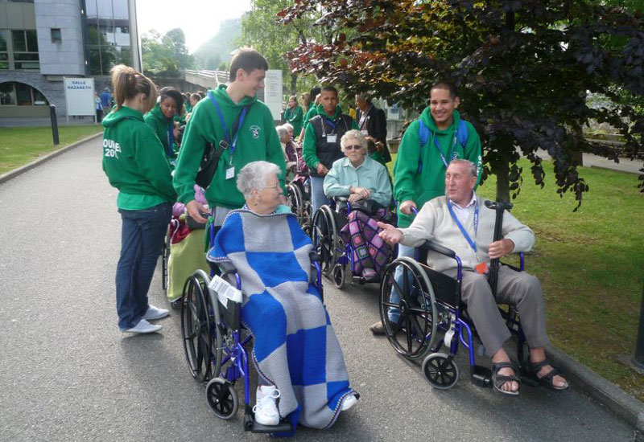
Thousands of people go to Lourdes every year in the hope that they will be healed.

Slide 13
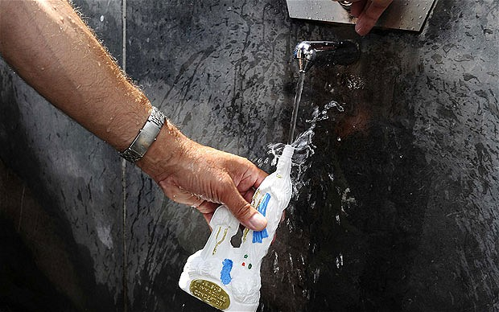
People collect the holy water from the spring to take home.

Slide 14
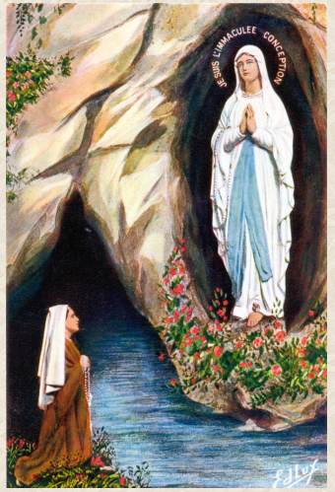
Visio Divina
Healing
Our Lady
of Lourdes
"I do not promise to make you happy in this life but in the next."

