Slide 1
Statutory Assessment
Tests
KS1 S.A.Ts
In 2014/15 a new national curriculum framework was introduced by the government .
In 2015/16 children in all years at Key Stage 1 and 2 were expected to study the new national curriculum.
KS1 (Year 2) and KS2 (Year 6) SATs will reflect the new curriculum.
SATs have not taken place for the last two years but will be happening this year in May.

Slide 3
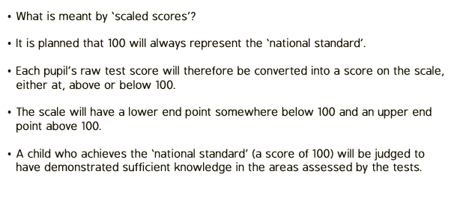

Slide 4
The papers are set and marked internally
In KS2 the tests are marked externally and are met with strict time limits. In KS1 it is more relaxed. They are marked internally by us and the time limit is more of a guideline.
We understand that they are only 6 and 7 years old. We want to minimise the stress as much as possible. We split the tests up over the week and we build in fun games and extra breaks to stop them from feeling overwhelmed.

Slide 5
The tests form part of the ‘picture’.
Teachers assess throughout the year, and throughout each lesson. We collect this information across the year to make a judgement as to how your child is doing in comparison to the National Expectations for children of the same age. This is known as Teacher Assessment.
Both Teacher Assessment and Test results are reported at the end of the year to give a broad picture of your child’s attainment.
You will be given a teacher assessment, and your child’s standardised score from the tests, alongside the average for the school, the local area, and national average.

Slide 6
The tests take place in May.
There will be written test papers in different subjects: Reading, Maths, Grammar, punctuation and spelling.
Writing is assessed through Teacher Assessment, using work produced throughout the next two terms.

Slide 7
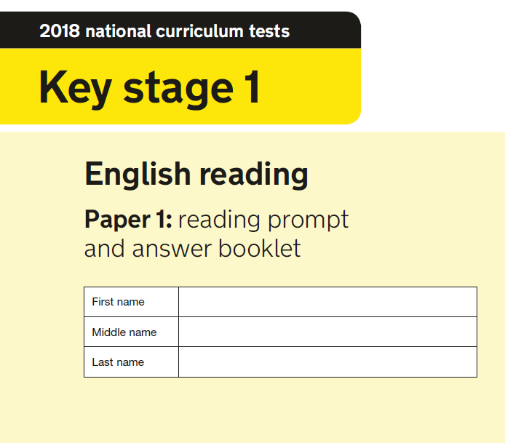
We have two reading tests, paper 1 has small amounts of text and then questions underneath it. Where as Paper 2 is made up of three separate texts, each becoming more challenging with the final text aimed at greater depth readers.
Paper 1
Paper 2

Slide 8
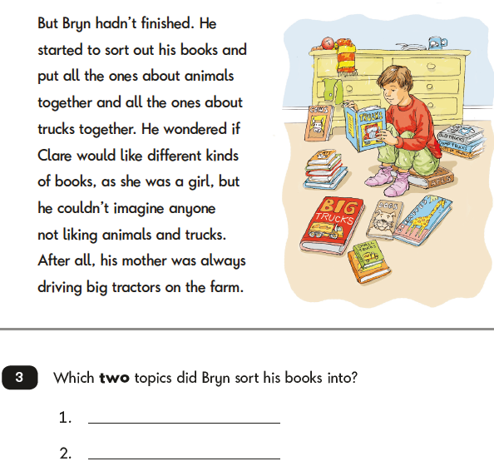
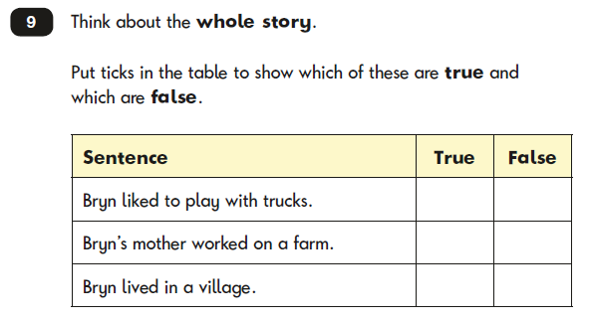
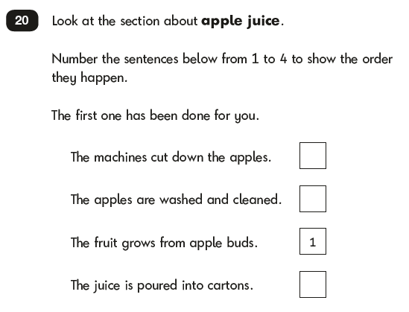
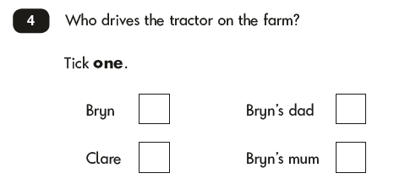
Examples from Paper 1

Slide 9
Guidelines for Paper 2
Approx. 1 hour to complete the test
Read one text and answer the questions for that text before reading the second text

Slide 10
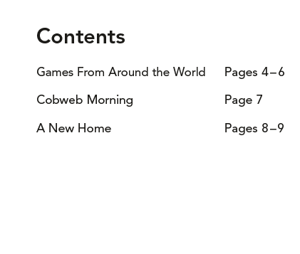
Paper 2
Each text can vary in genre, structure and length. It is very clear for the children to understand when one text ends and another begins as it will have a new title, layout and background.

Slide 11
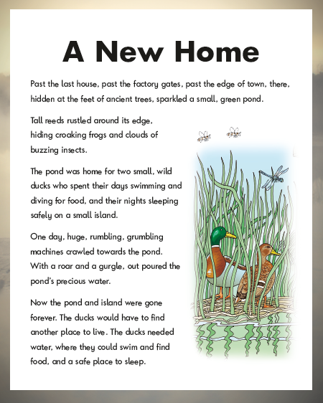
Examples from Paper 2

Slide 12
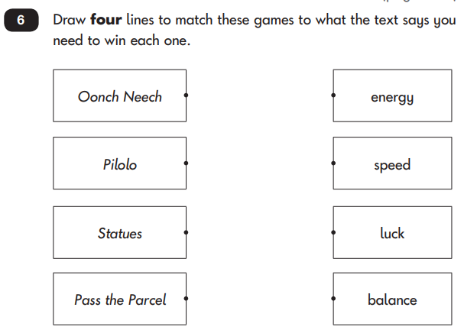
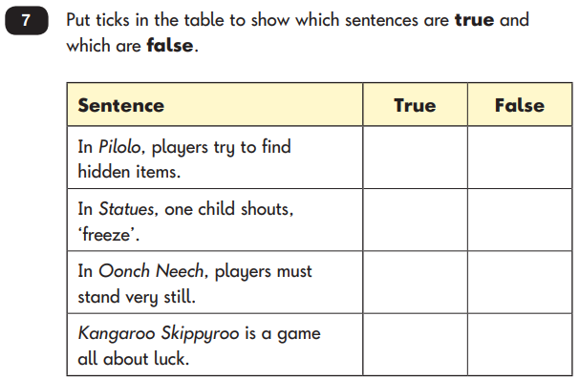
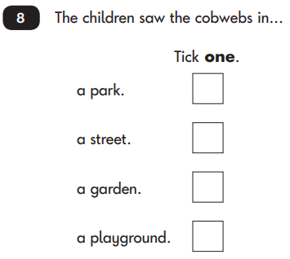
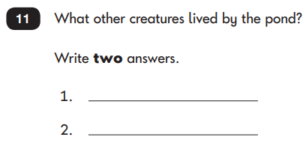
Examples from Paper 2

Slide 13
How to help your child at home:
Read every day. This widens vocabulary which is vital for the GAPS and reading tests and gives a deeper understanding of the world around them which will prepare them for the different texts.
We will be sending home SATs packs for children to practise as well.
Oak academy
https://classroom.thenational.academy/subjects-by-year/year-2

Slide 14
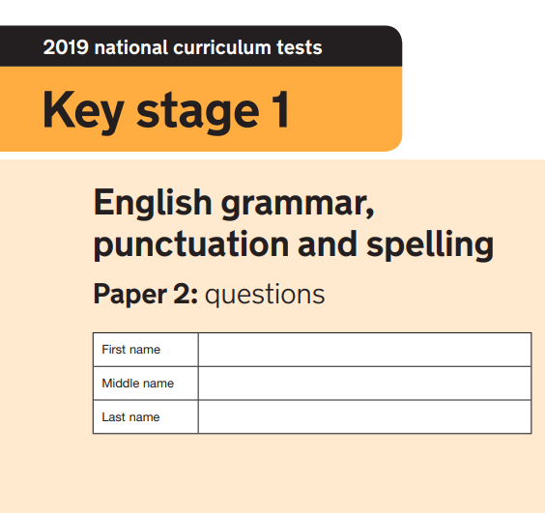
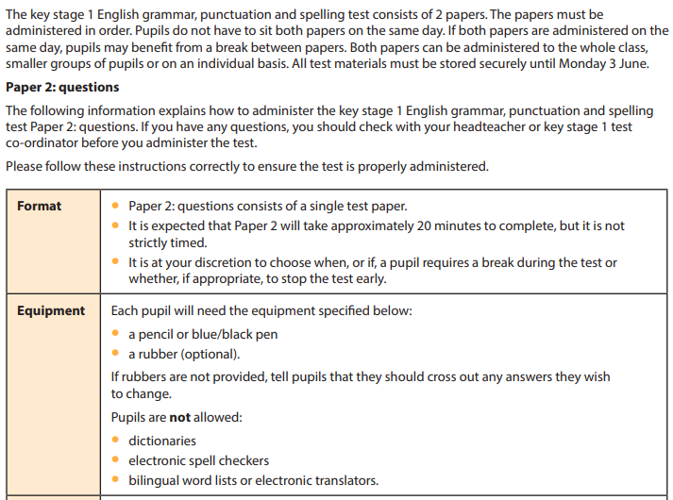
Spelling, Punctuation and Grammar are assessed through two external papers.

Slide 15
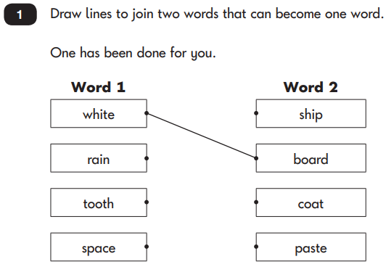
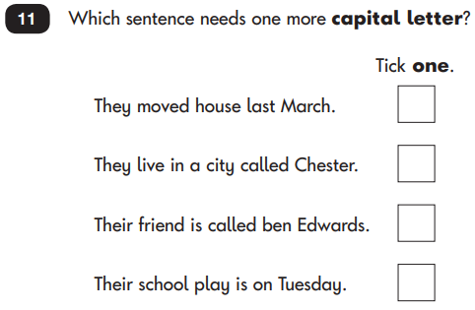

Slide 16
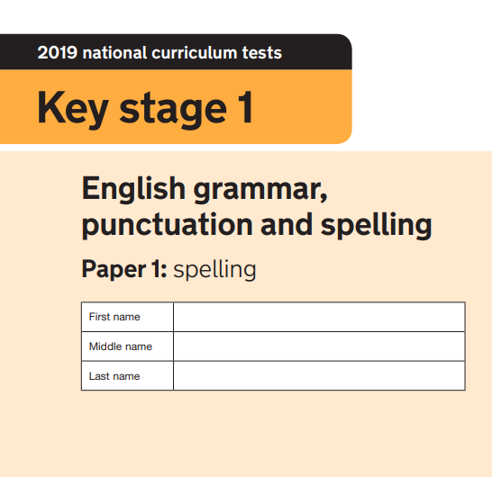
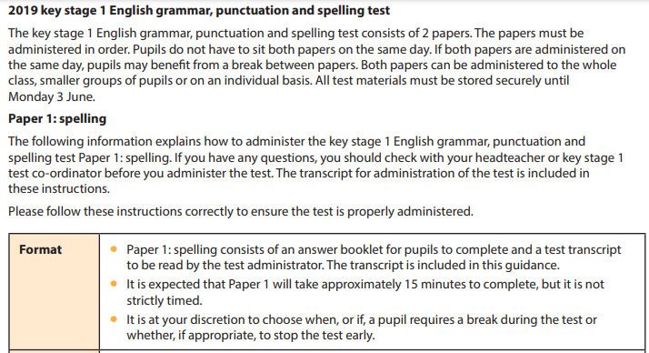

Slide 17
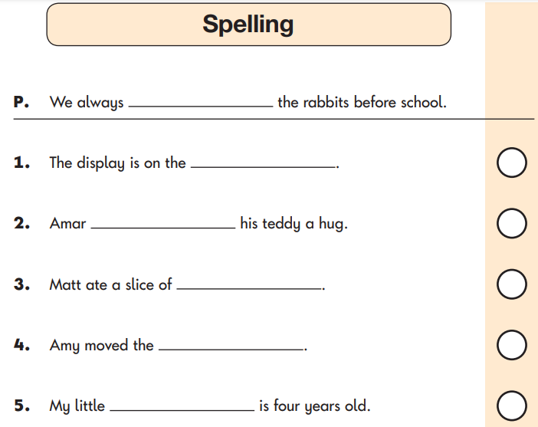

Slide 18
How to help your child:
Help them learn their spellings – all words from the year 1 and 2 lists (we can email these out again if you do not have a copy).
This is also why we give them spellings to learn each week. The first 10 are based on the phonics sounds that we are learning and the last 5 are always ‘tricky words’ (words that cannot rely on phonetical knowledge).

Slide 19
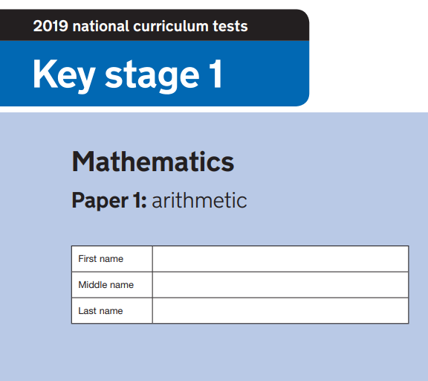
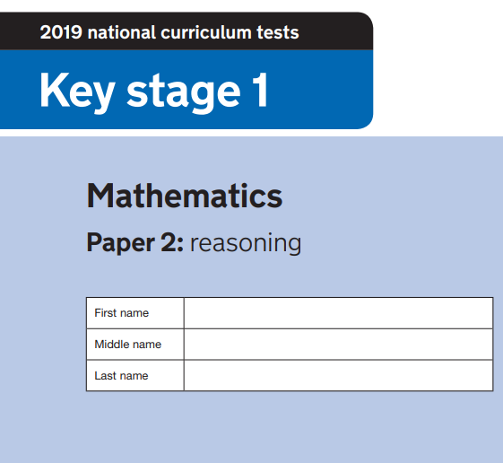
The tests take place in May.
There will be 2 separate maths papers:

Slide 20
Paper 1: Arithmetic (approx. 20 minutes)
Fixed response questions, where children have to give the correct answer to calculations, including addition, subtraction, multiplication, division and fractions.
The questions are designed to gradually get harder. Not all children will be expected to access some of the later more difficult questions

Slide 21
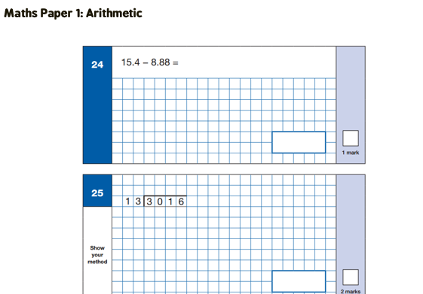
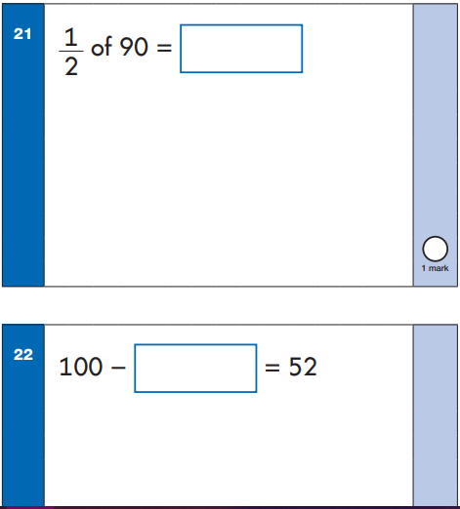
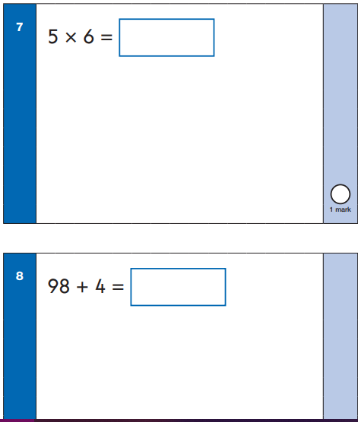
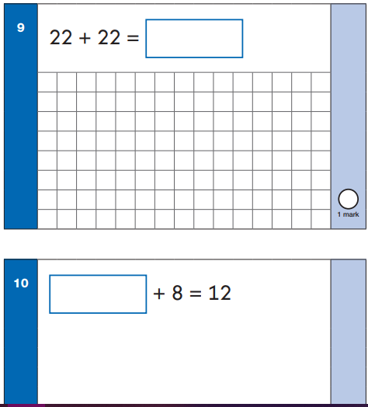
This the easiest paper to revise for, as the calculations follow taught rules and ‘procedures’. Out of 25 possible marks, this is a good opportunity to get the maximum marks

Slide 22
Paper 2 ‘Reasoning’ (30 minutes)
Mathematical fluency,
Solving problems and
Reasoning.
Children will still need and
use calculation skills, but
will need to use these in
context, and decide on the
Mathematics needed to
answer the question.
They are often asked to
explain their reasoning in
words.

Slide 23
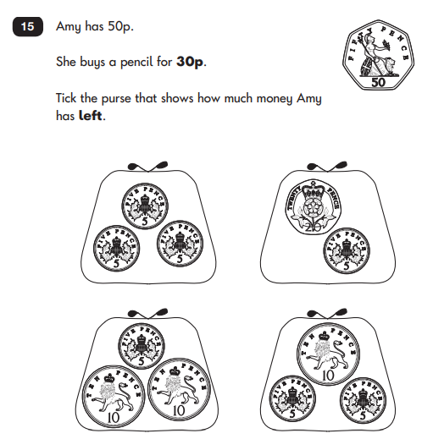
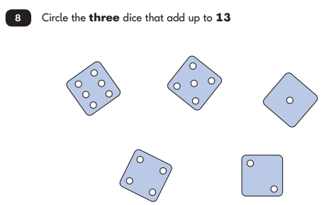
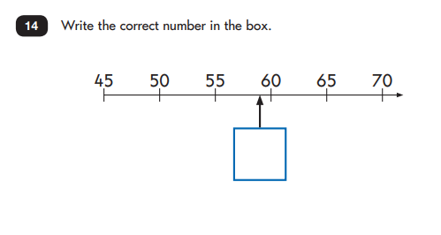
The first 5 questions are read to the children and it tests their listening skills as well as their mathematical knowledge.
The other questions may include:
Multiple choice
True or false
Ticking the correct answer
Matching

Slide 24
How to help your child:
Practice rapid recall of times tables facts.
Practice spellings with them
Talk about what your child has learnt each day.

Slide 25
How to help your child:
Support and reassure your child that there is nothing to worry about and that they should always just try their best. Praise and encourage!
Ensure that they have the best possible attendance in school. One day missed can make a huge difference.
Support your child with any homework sent home.
Practice reading, spelling and arithmetic.
Talk with them about what they have been learning in school that day, what books they are reading (the character, the plot, their opinions)
Make sure that your child has a good nights sleep, and breakfast so that they arrive ‘bright eyed and bushy tailed’!

