Slide 1
wednesday
^{3rd february}

Slide 2
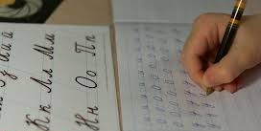
Morning activity
Handwriting challenge!
Write out the three common exceptions words below 5 times each.
where there here

Slide 3
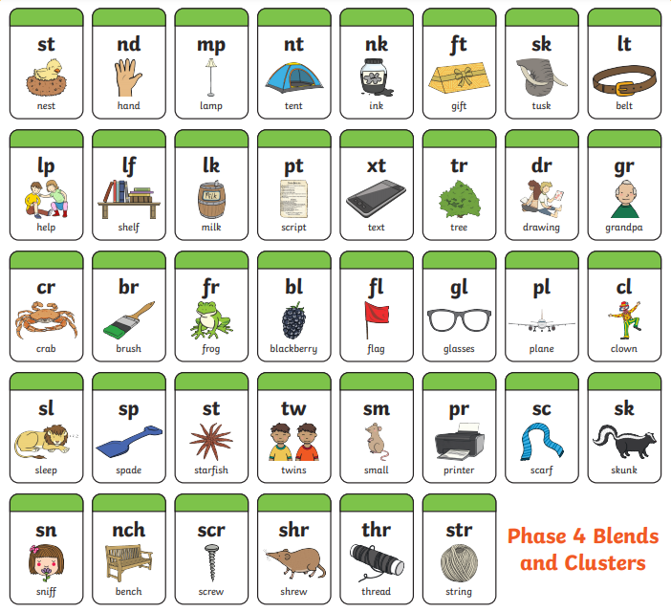

Slide 4
phonics
st tw nd sm mp pr nt sc nk sk ft sn sk nch lt scr lp shr lk thr lp str pt xt tr dr gr cr br fr bl fl gl pl cl sl sp st
We are going to learn fl
​1] Read out all the blends we have learnt so far in Phase 4.
2] What is today’s blend? How many times can you write ‘fl’ in 1 minute?
3] ​Which of the words on the next slide is not an ‘fl’ word? Practice reading the 3 ‘fl’ words on the next slide.
​4] Write a sentence using one of the ‘fl’ words on the
next slide. Challenge – can you write a sentence for the 3 ‘fl’ words?

Slide 5
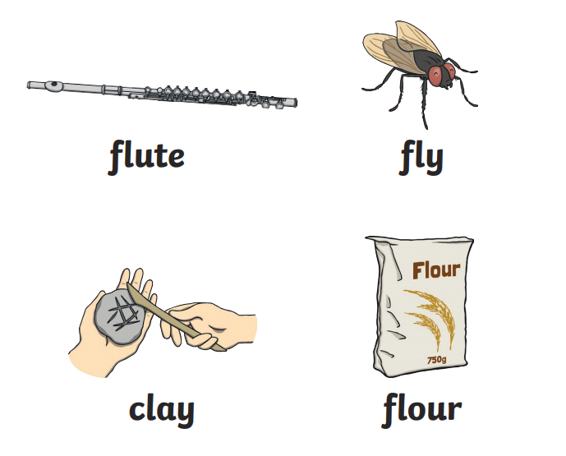

Slide 6
BREAK TIME – 10:10 – 10:20
Enjoy a stretch, a bit of movement, a drink and snack to refresh your brain.

Slide 7
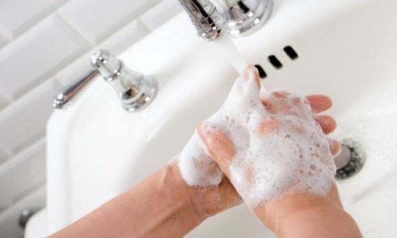
Wash your hands

Slide 8
Wednesday Maths
Today we are counting forwards and backwards to 50.
Watch the video below for today’s lesson.
https://vimeo.com/500467345

Slide 9
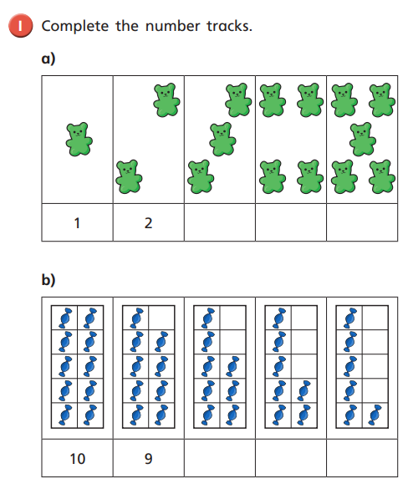
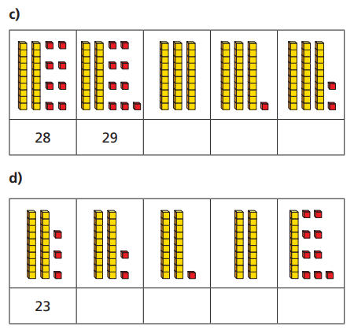
Mild
Spicy

Slide 10
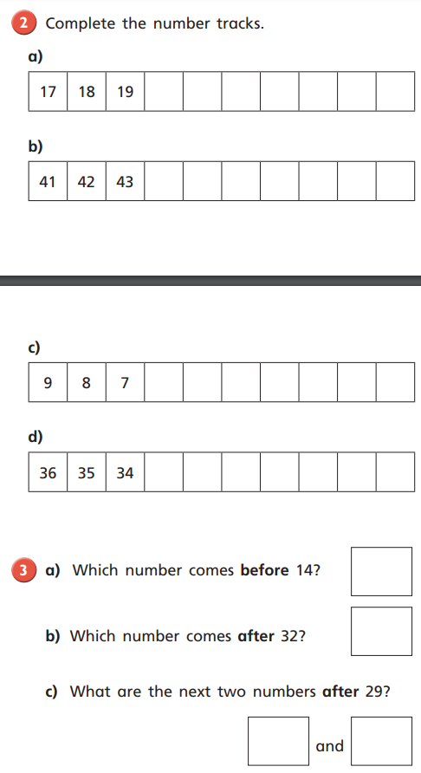

Slide 11
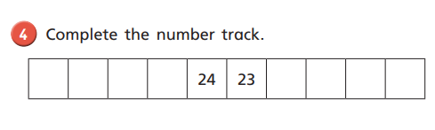

If there are any numbers that you find tricky then keep practising writing and reading these numbers.
Challenge:
For those who can count confidently to 50, keep practising with numbers to 100.
Can you make the numbers 72 and 84 using our tens and ones pictures?
63

Slide 12
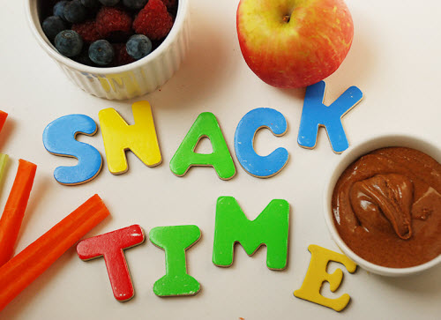
Snack time

Slide 13
ENGLISH
L.O. I can start to use capital letters for ‘naming words.’
We are doing a really good job of starting our sentences with capital letters. Now we need to start thinking about using capital letters for names.
So…..when should we use a capital letter?

Slide 14
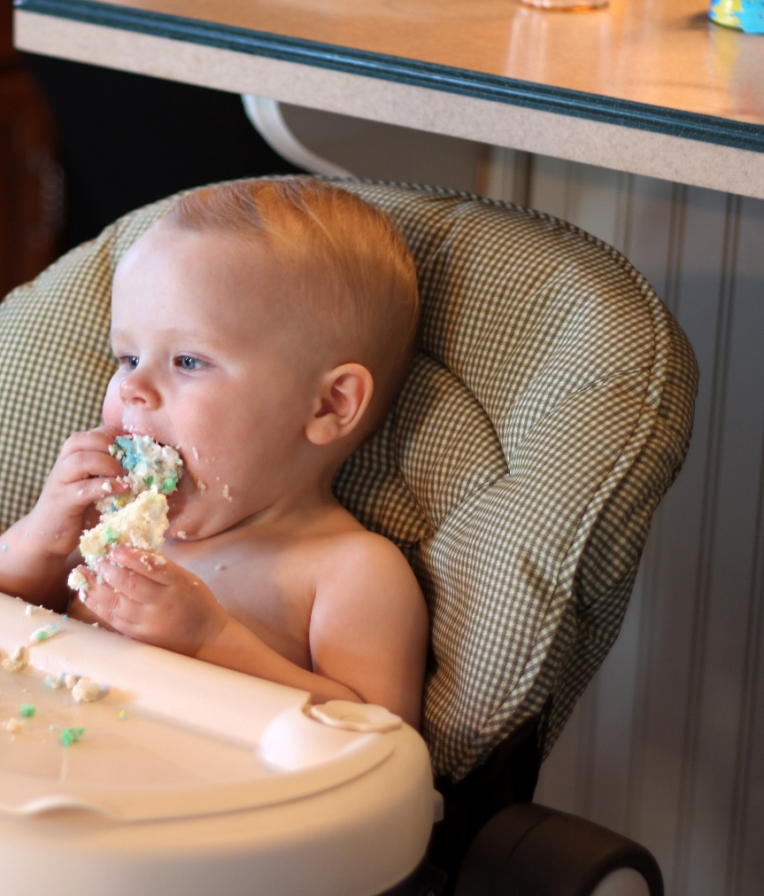
Starting Sentences
Capital letters are always used to start sentences
He loves to eat cake!
Photo courtesy of viviannguyen(@flickr.com) - granted under creative commons licence – attribution

Slide 15
Proper Nouns
Nouns are naming words.
Proper nouns are naming words for individual people, places, days of the week and months of the year.
Proper nouns all need capital letters.
Common Nouns | Proper Nouns
girl | Helen
country | England
city | Sheffield
football team | Nottingham Forest
day/month | Monday/September

Slide 16
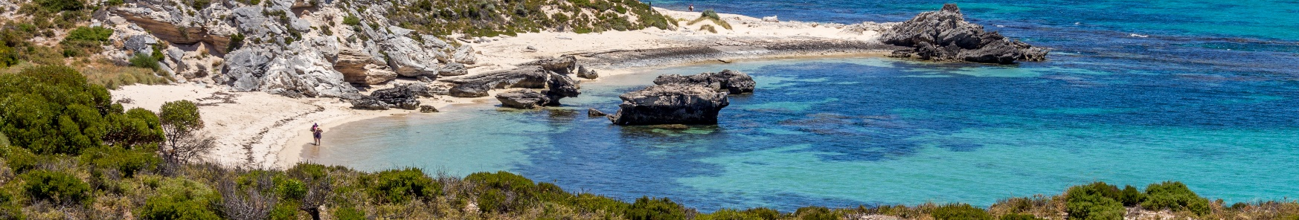
Activity
Can you spot the proper nouns in these sentences and add
capital letters to the beginning of them?
Have a go on your whiteboard.
ben and susan went to australia for their holidays.
Ben and Susan went to Australia for their holidays.
owen supports hull city fc.
Owen supports Hull City FC.

Slide 17
challenge
Can you write the names of 5 countries around the world and include the capital letter correctly?

Slide 18
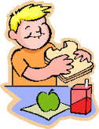
LUNCHTIME
“Bless us o God…….”

Slide 19
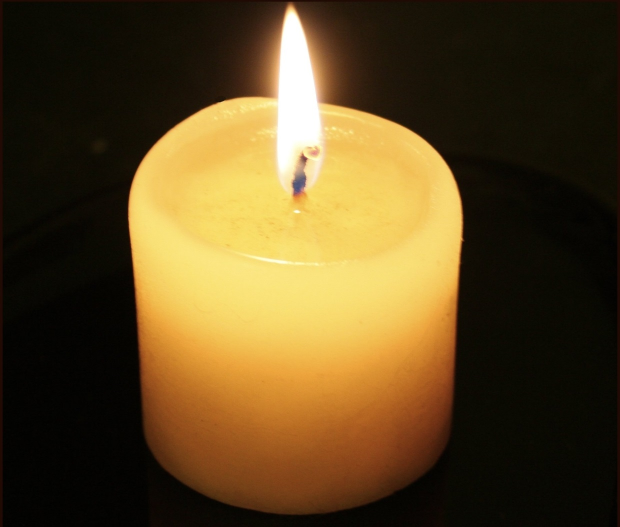
MEDITATION

Slide 20
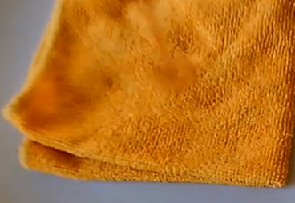

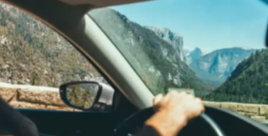
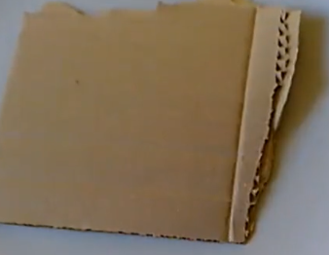
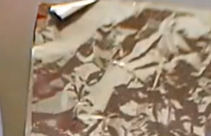
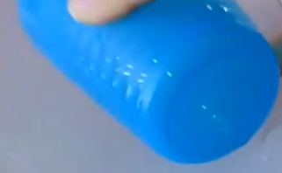
Science Everyday Materials

Slide 21
LO: I can recognise if a material is absorbent or not.
That simply means…
I can tell if a material is absorbent (waterproof) or not.
What is absorbent? What does it mean?

Slide 22
An absorbent material is…
a material which can soak up liquid.
Do you know materials that are absorbent?
Look around in the room and talk with an adult/older sibling.

Slide 23
Why do paper towels need to be absorbent?
So that they can soak up spilled liquids.

Slide 24
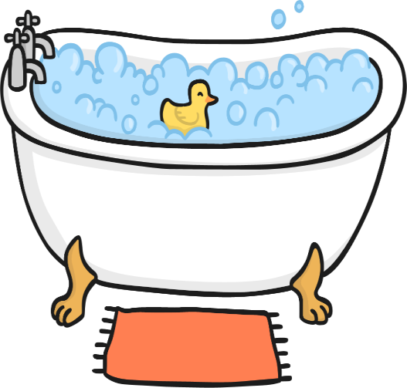
Why does a bath mat need to be absorbent?
So that it can soak up water when you get out of the bath and stop the floor from getting wet.

Slide 25
Why does a towel need to be absorbent?
So that it can soak up water and help to dry your body.

Slide 26
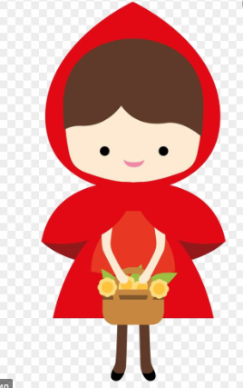
Little Red Riding Hood Task: We need to suggest a material for making Little Red’s hood.
Talk with your adult/older sibling:
Would Little Red Riding Hood need her hood to be made out of absorbent materials or non-absorbent (waterproof)?
(That is a fair prediction).
Let’s test some everyday materials to see if your prediction is right or not by doing an experiment!
You can carry out this experiment safely yourself with an adult OR use the link on the next slide to see it done by someone else..

Slide 27
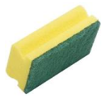
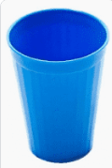


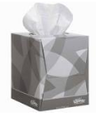
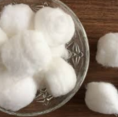
Materials we need for our experiment: (you can find something similar to these)
Sponge or a cloth
Plastic carry bag or plastic cup
Cardboard or paper
Cotton wool or tissue

Slide 28
Method:
Take each material one at a time. Place it on a plate.
(Challenge: make a prediction)
Pour a few drops of water on it.
Observe what happens to that water.
Is it all in the plate? Has some of it been absorbed (soaked) by the material?
4. Write down the result into a table. (draw one like on slide 12)
5. What do you notice? Which is the most waterproof material fit for the hood?
(Challenge: I predicted …………… to be the waterproof material and my prediction was correct/ incorrect).

Slide 29
Written work Draw this table and write your test results in your notebook like this:
Material | Absorbent/Non-absorbent | Good for Little Red Riding Hood
Cotton Wool
Newspaper
Sponge
Plastic

Slide 30
Written work continued
____________ would be a good material for Little Red Riding Hood’s cape because it will help to keep her dry.
Challenge:
I predicted …………… to be the waterproof material and my prediction was correct/ incorrect.

Slide 31
Afternoon break 1.40 pm
Enjoy a stretch, a bit of movement, a drink and snack to refresh your brain.

Slide 32
Wash your hands

Slide 33
Counting in 2s practice
Use this as a fun way to start counting in 2s. In Year 1, counting in 2s, 5s and 10s is really important.
https://www.youtube.com/watch?v=OCxvNtrcDIs

Slide 34
Prayer to end the day
God our Father, I come to say
Thank you for your love today.
Thank you for my family and all the friends you give to me.
Guard me in the dark of night and in the morning
Send your light.
Amen.

